Slide 1
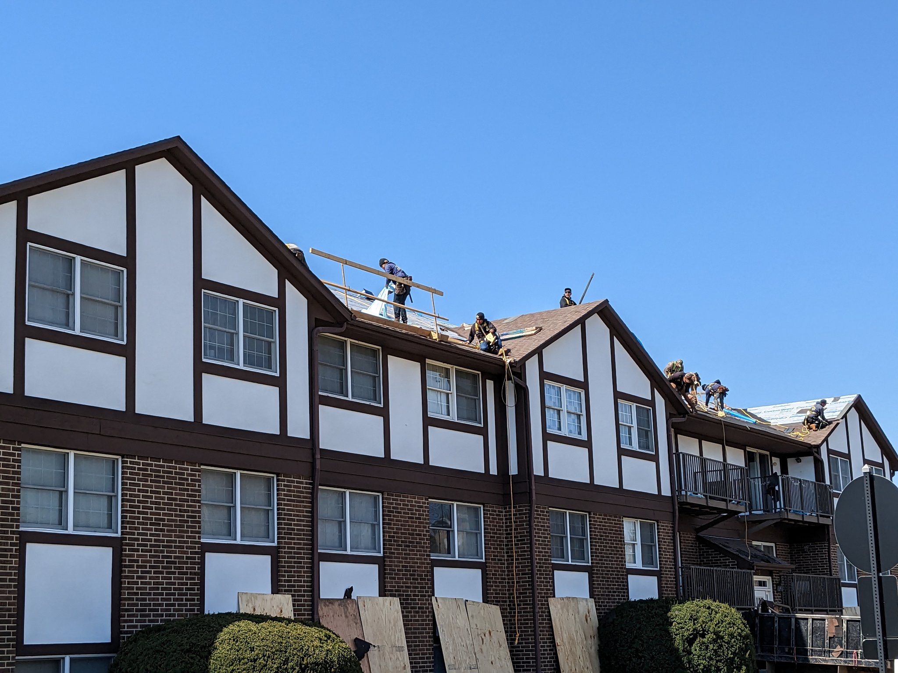
Residential Roofing Safety
Draft 4 8 2023
John Newquist

Slide 2
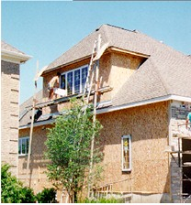
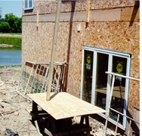
Fall Protection – The Problem
Falls are a serious safety concern in the jobsite.
Falls are the leading cause of worker deaths in construction.
Scaffold in Dupage County

Slide 3
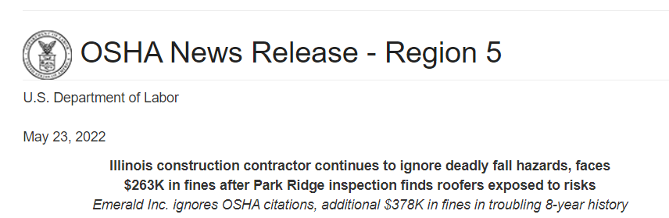
2022

Slide 4
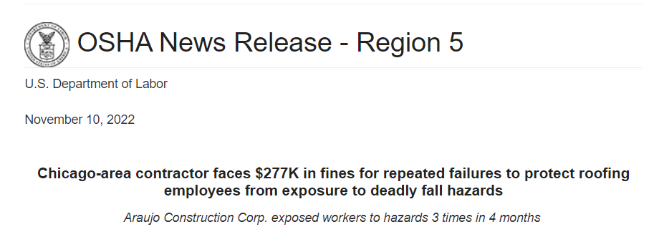
2022

Slide 5
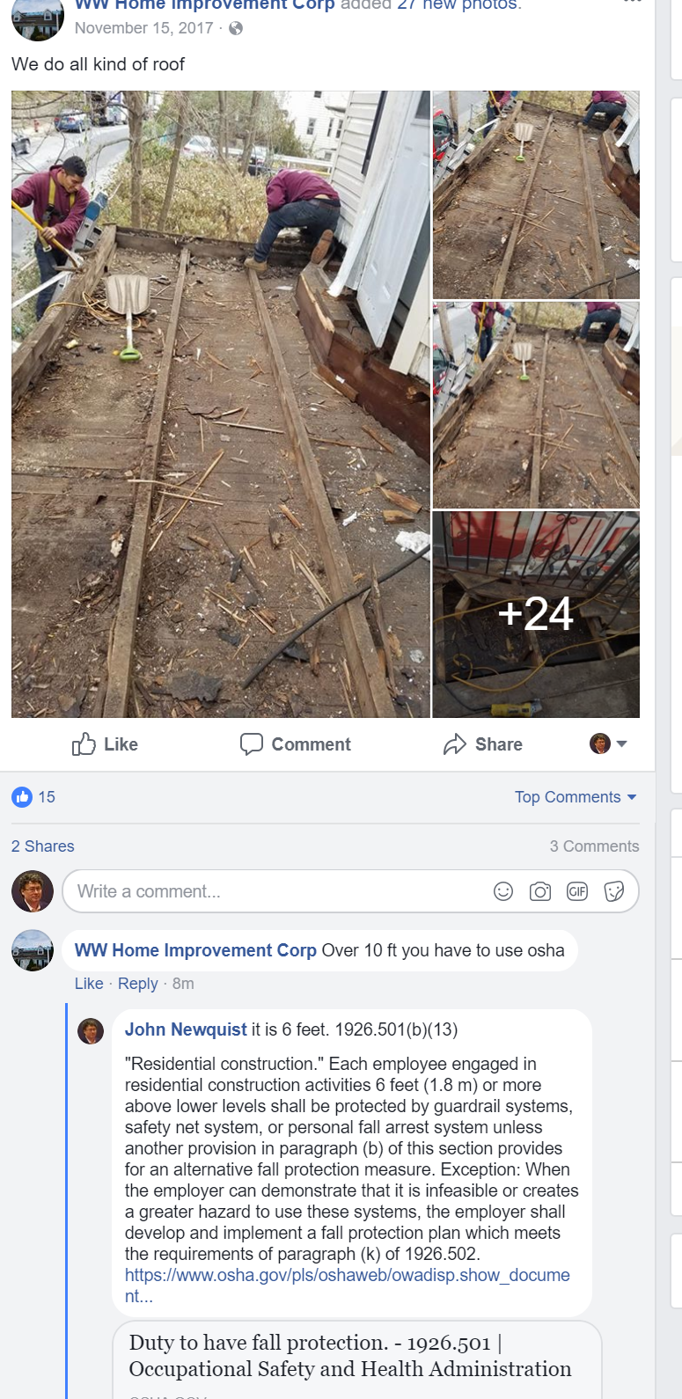
Mar 2018

Slide 6
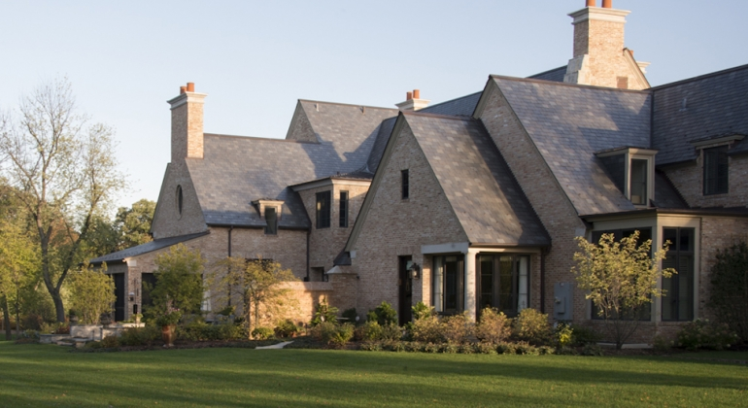
OSHA
April 2013
$47,960 for exposing workers to falls of heights up to 20 feet and other hazards.
Woodridge Enterprises Inc., of Lemont, was cited for eight alleged safety violations—three repeat and five serious—at a residential job site in Hinsdale, IL,.

Slide 7
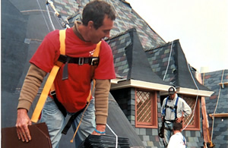
OSHA
Feb 2014
$158,015 against an Illinois roofing company.
The company, Affordable Roofing and Exteriors, Inc. of Trenton, Ill., was cited after inspections at three job sites where workers were improperly using fall protection during the installation of shingles on residential roof

Slide 8
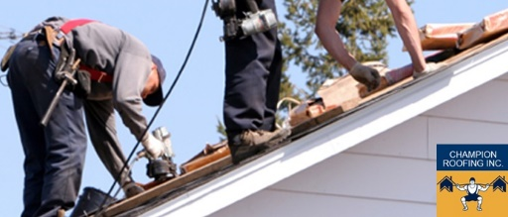
OSHA
Aug 2014
Champion Roofing fined $48K for 2 willful safety violations
after workers exposed to dangerous fall hazards in Bradley, Illinois

Slide 9
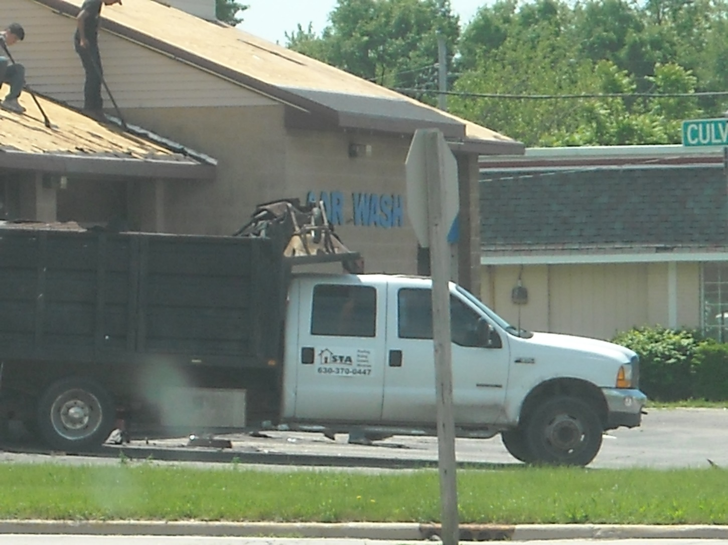
Hazard Recognition

Slide 10
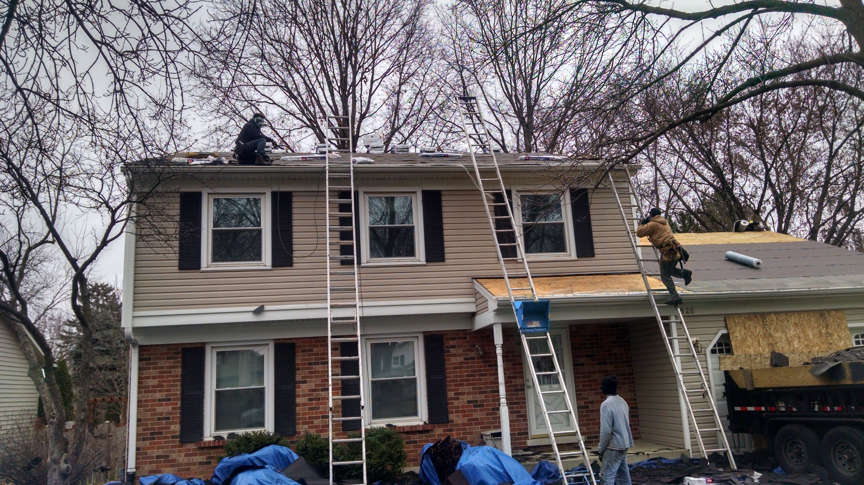
Hazard Recognition

Slide 11

Hazard Recognition

Slide 12
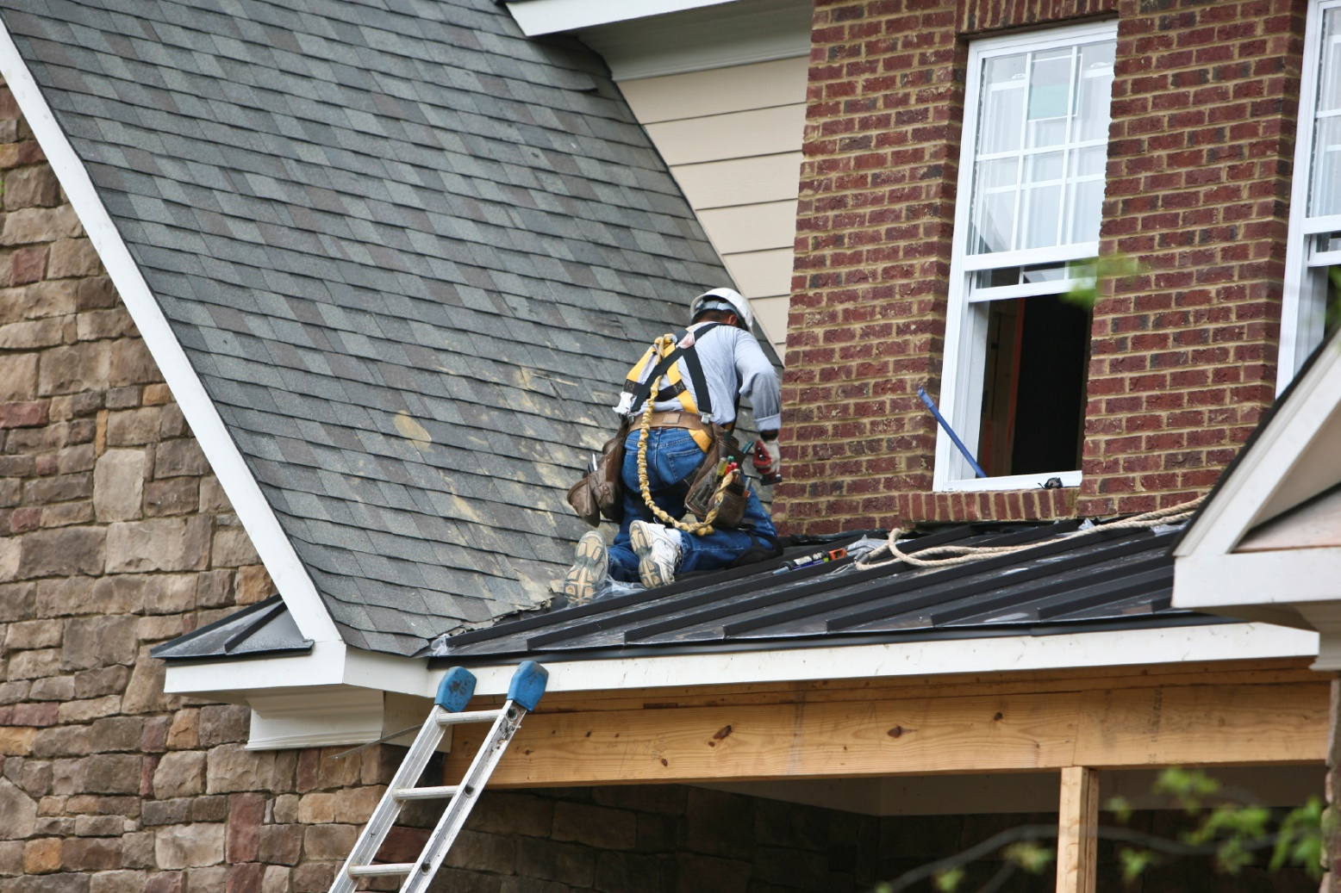
Hazard Recognition

Slide 13
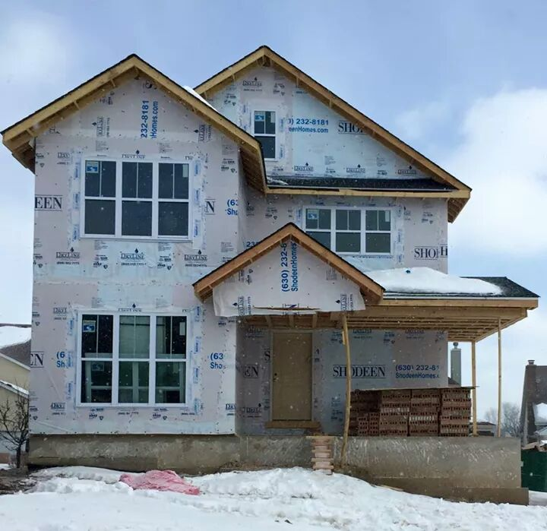
Hazard Recognition

Slide 14
Sales Impact of Selected Injuries
Three
Notes:
14
Here are some other examples of injuries, costs and sales needed to pay for an accident. The sprain example was shown on the previous two slides.

Slide 15
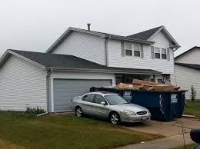

Lawsuits
D.B. V. J.L. ADLER ROOFING INC. ET AL.:
$5.7 million settlement for a 27-year-old Joliet, IL roofer in a workplace injury case who was paralyzed when he fell from a roof as a result of the general contractor's failure to provide appropriate safety devices.

Slide 16

Quadraplegic
In August 2010, Quelino Ojeda Jimenez, an undocumented construction worker in Chicago, fell 20 feet off a building while on the job and was paralyzed from the neck down.
Unable to pay his own medical expenses, he was deported back to Mexico on December 22, 2010.
But he never made it home. Instead, he was left to languish at a small Mexican hospital that was unequipped to handle his needs. UPI reports that Ojeda died on New Year’s Day:

Slide 17
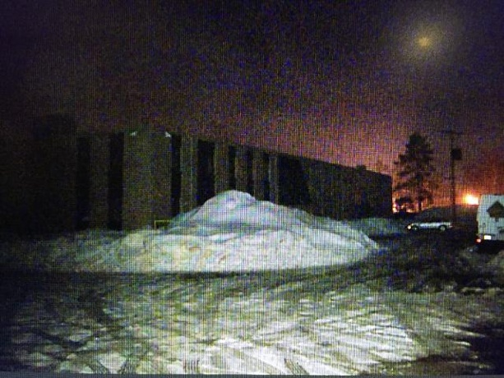
February 2015
Canton MA
The victim and another worker were on the roof assessing snow removal operations.
They separated and one person walked across a skylight that had been covered by the snow.
The light gave way and he fell 40 feet to his death.

Slide 18
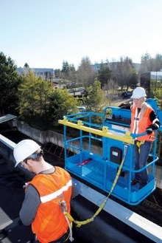
February 2015
Genie
Allows a user to exit the platform and work comfortably around the outside of the platform with a 6-ft lanyard. It attaches to a 6- or 8-ft platform on all Genie telescopic and articulating boom lifts with lift heights higher than 40 ft., with the exception of the S-125HD model.

Slide 19
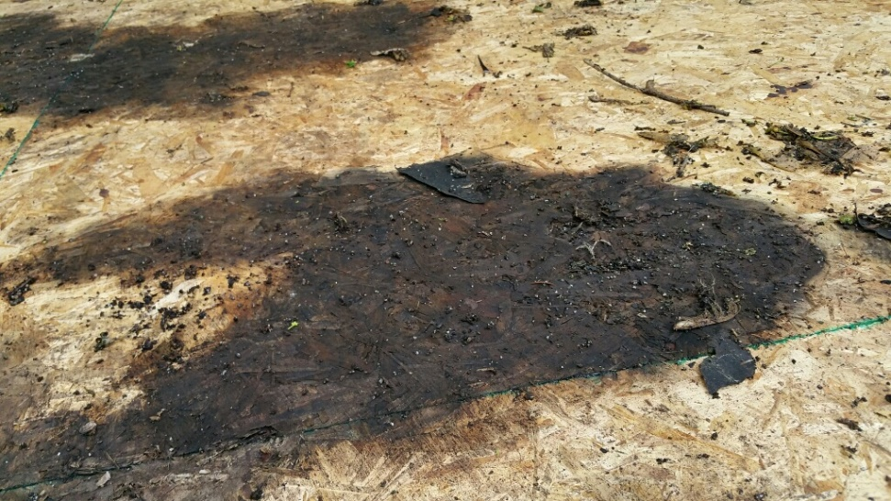
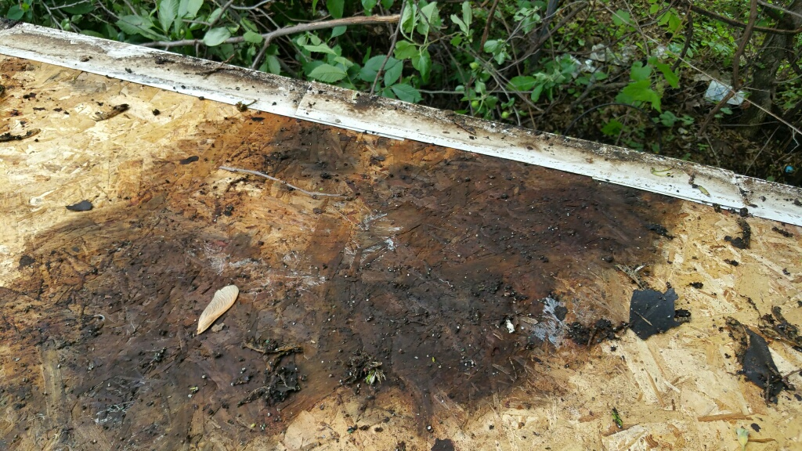
May 2015
Roof rot

Slide 20
Skylights and scaffolds not in top five now.
Region 5 is seeing more non construction falls than construction falls.

Slide 21
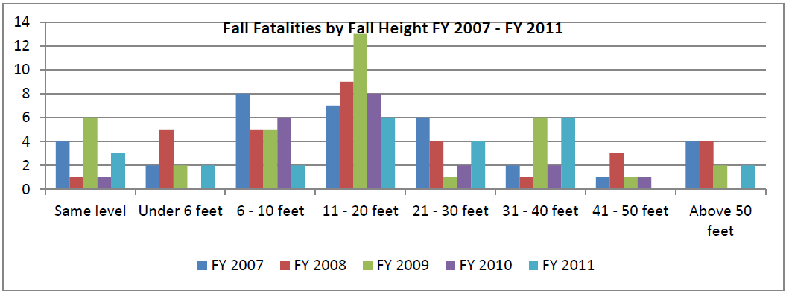
Heights Falling?
Region V fatality data 2007-2011
Notes:
From 2008 OSHA study.

Slide 22
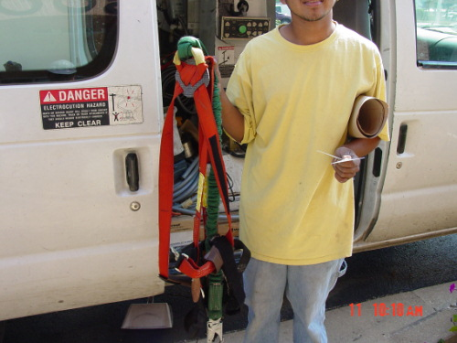
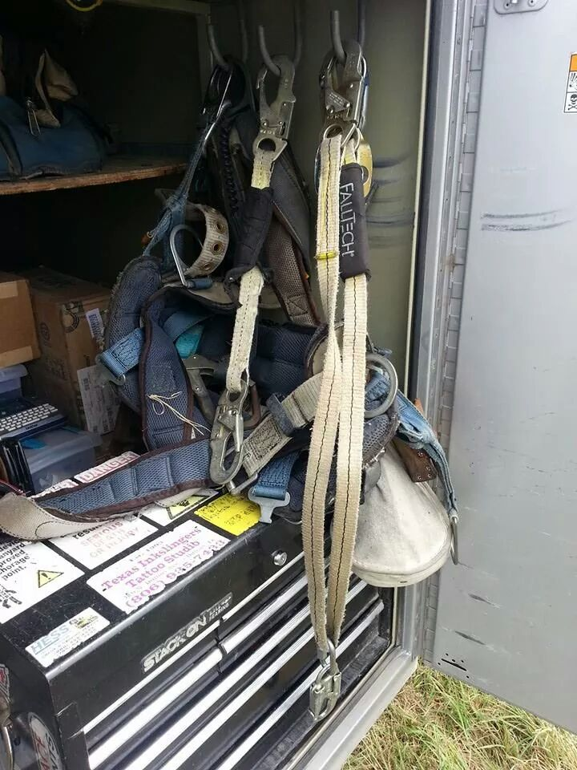
Inspections
Conduct periodic inspections
Is fall arrest is worn?
Is fall protection is place?
Take pictures of people doing it right

Slide 23
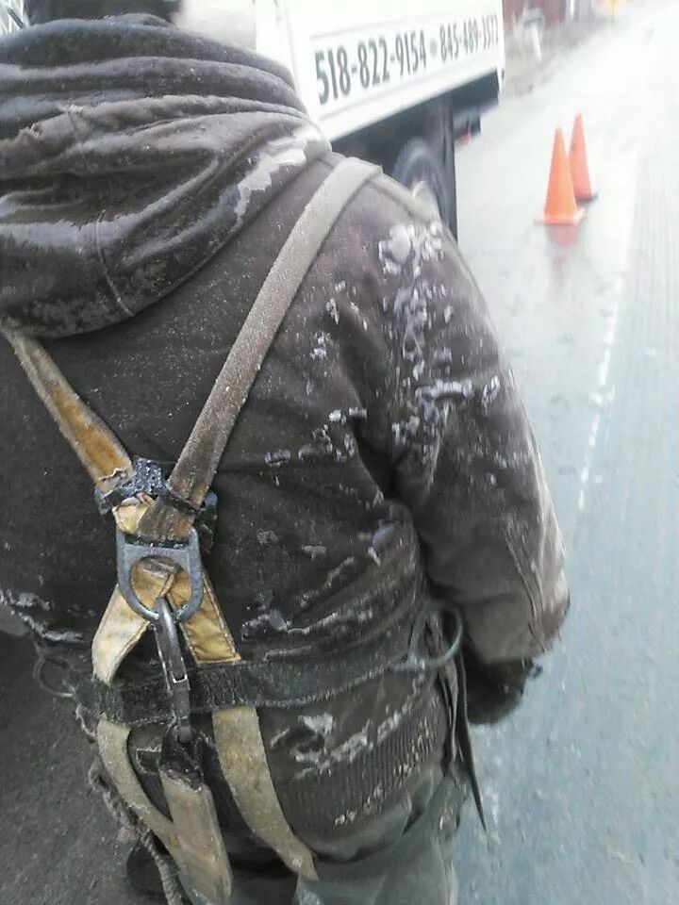
Inspection
December 2014

Slide 24
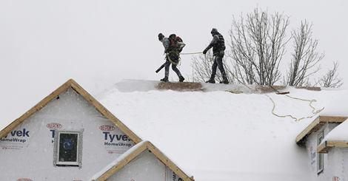
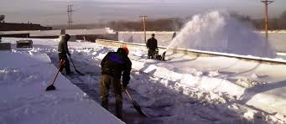
Snow and Ice
Many falls while getting up on roofs.
Issues?

Slide 25
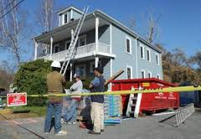
Dec 2013
OSHA - two willful, following the death of a worker.
On June 27, a worker was electrocuted at a residential jobsite in Boca Raton when his employer directed him to reposition a metal extension ladder in close proximity to overhead electrical power lines that had not been de-energized, grounded or guarded.

Slide 26
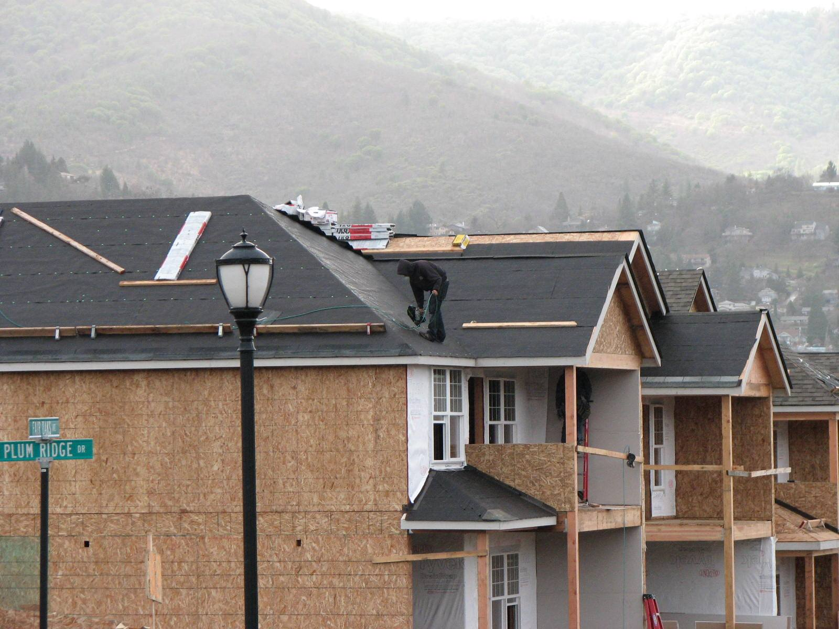
December 2014
Safe or not safe?
Notes:
Photo Oregon osha

Slide 27
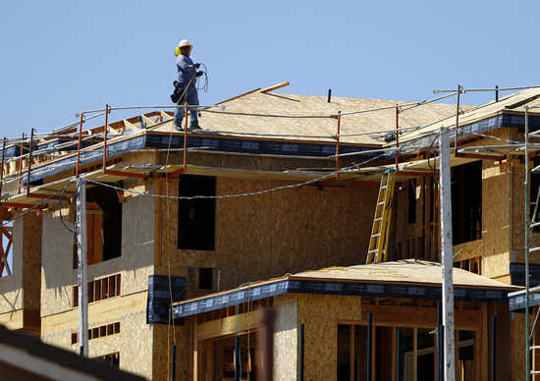
January 2015
Texas
Roof Fall Protection

Slide 28
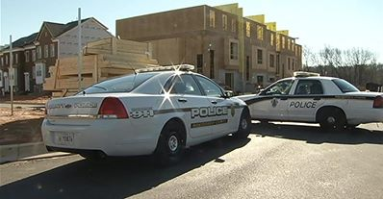
Dec 2013
MD
A man working in the garage level of a row of town houses under slipped on a small patch of ice, fell and struck his head and died.

Slide 29
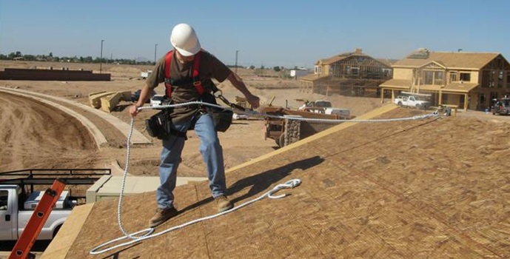
OSHA
1926.503(a)
"Training Program."
The employer shall provide a training program for each employee who might be exposed to fall hazards. The program shall enable each employee to recognize the hazards of falling and shall train each employee in the procedures to be followed in order to minimize these hazards.

Slide 30
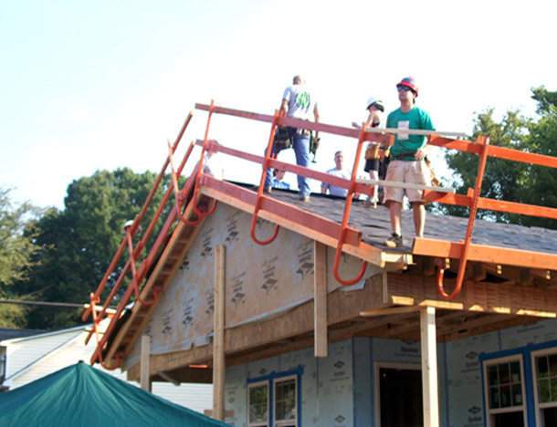
OSHA cont
The employer shall assure that each employee has been trained
The nature of fall hazards in the work area;
The correct procedures for erecting, maintaining, disassembling, and inspecting the fall protection systems to be used;
The use and operation of guardrail systems, personal fall arrest systems, controlled access zones, and other protection to be used;
The correct procedures for the handling and storage of equipment and materials and the erection of overhead protection; and
The role of employees in fall protection plans;
The standards contained in this subpart.

Slide 31
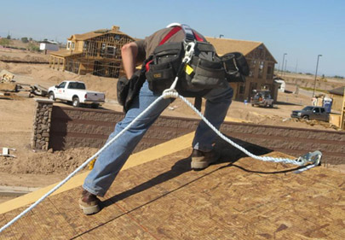
"Certification of Training."
1926.503(b)(1)
The employer shall verify compliance with paragraph (a) of this section by preparing a written certification record. The written certification record shall contain the name or other identity of the employee trained, the date(s) of the training, and the signature of the person who conducted the training or the signature of the employer. If the employer relies on training conducted by another employer or completed prior to the effective date of this section, the certification record shall indicate the date the employer determined the prior training was adequate rather than the date of actual training.

Slide 32
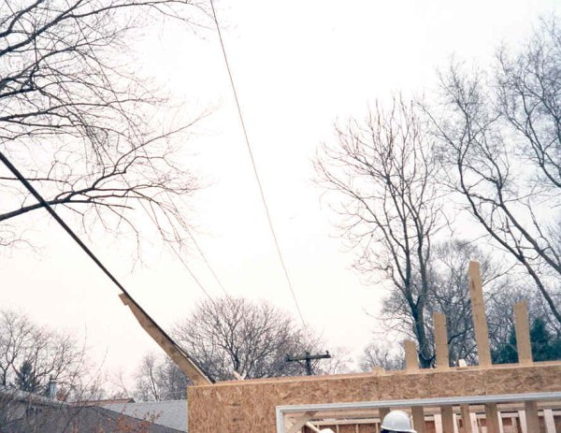
Electrocutions
Powerlines – 18
(Most ladders and gutters)
Pressure tank – 1
Air Handler – 1
Lighting circuit – 1
Electrical cord - 1
10 feet away is required.
Notes:
Victim and another worker were in the process of doing some siding work to a residential home. They removed an antenna from the side of the home when it came in contact with a 7200 volt power line and victim was fatally shocked.
Interview with wife of deceased on 15 September 2005: Wife, Cheri, was helping husband (Jerry) in replacing a pressure tank. A pressure tank is like, "a personal water tower." the wife turned the power on to see if the tank was functional (water entering the tank). Jerry was reaching to shut off the valve when he brushed against the switch, and was electrocuted. The wife unplugged the power (tank). The Paramedics transported Gerald to Central DuPage Hospital. Coroner = "Death by electrocution."
At 3:00pm, employee was working alone in a new residence while removing an air diverter from an installed residential heat pump inside air handler's duct work. The duct work in which the diverter was located was directly below the air handler, which had the 20 kilowatts auxiliary heating coils, 230 volts. The victim cut out the side of the duct work to gain access to the screws that held the diverter in place. The power was not turned off to the air handler. The victim put his head into the duct work, attempted to pull the diverter toward him in the limited space to access the last two screws, and raised his head into the heating element. The victim was electrocuted.
On October 04, 2006 at approximately 4:00 p.m. two gutter installation employees were working from a ladder jack scaffold. The gutter that they were installing made contact with a high voltage over head power line resulting in the electrocution death of one of the employees.

Slide 33
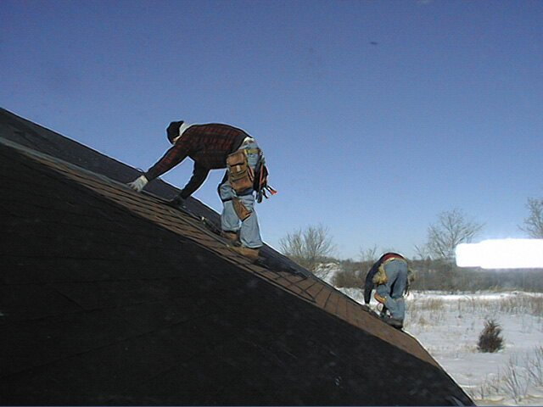
Shingling Falls
Most the falls are those with no fall protection
Workers can slip on shingle or felt to start slipping
No slide protection used
Notes:
Victim and another employee were staging bundles of shingles on the second story roof of the newly constructed house. Both employees were on the east side of the house near the valley when the victim slipped on ice or frost on the roof and fell 21 feet to the ground below. The victim was transported to the hospital where he died the next day.
Employee was installing roofing material on existing building when employee fell from roof.

Slide 34
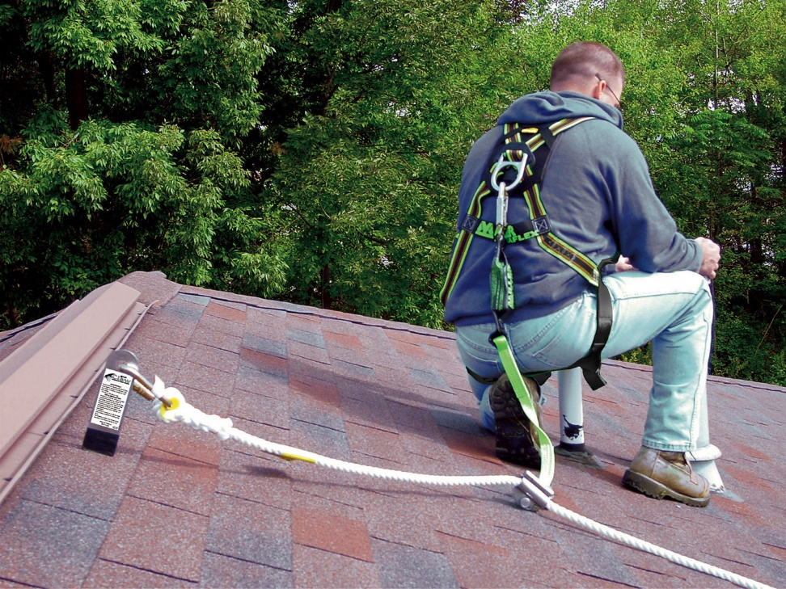
Shingling Abatement
Slide guards not acceptable
Convention Fall protection must be used

Slide 35
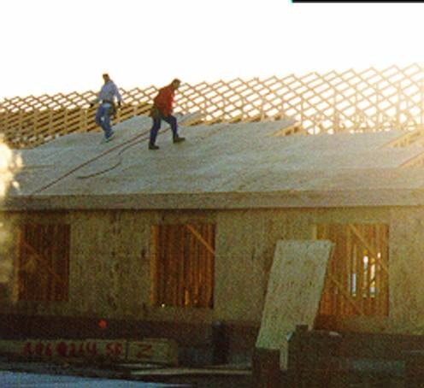
Roof Sheathing
Conventional Fall Protection
If not Feasible Alternative Fall Protection requiring:
Written Fall Prevention Plan
Monitor
CAZ
Slideguards
Training
No slide guards used

Slide 36
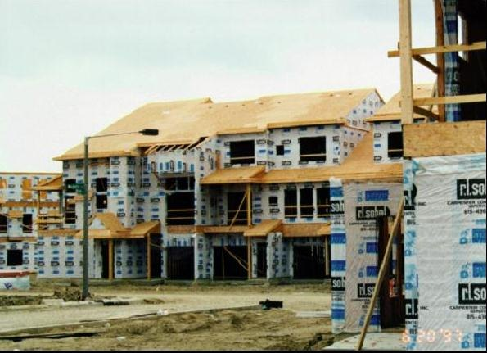
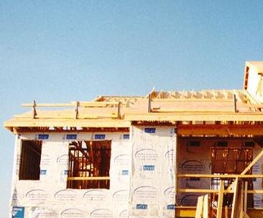
Sheathing Abatement
Conventional Fall Protection used
Slideguards used on the roofs.

Slide 37
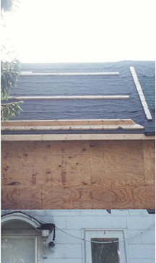
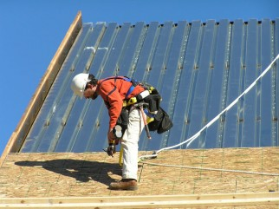
Slides Guards?
Before: Alternative measures such as slide guards acceptable
Now: Prove that the use of conventional fall protection is infeasible or created a greater hazard
Proof is via written fall protection plan
Notes:
Prior to the issuance of this new directive, STD 03-
00-001 allowed employers engaged in certain
residential construction activities to use specified
alternative methods of fall protection (e.g., slide
guards or safety monitor systems) rather than the
conventional fall protection (guardrails, safety nets,
or personal fall arrest systems) required by the
residential construction fall protection standard (29
CFR 1926.501(b)(13)). Employers could use the
alternative measures described in STD 03-00-001
without first proving that the use of conventional fall
protection was infeasible or created a greater
hazard and without a written fall protection plan.
From OSHA Fact Sheet
Slideguards cannot simply be used in lieu of conventional fall protection methods under 1926.501(b)(13). However, slideguards may be used as part of a written, site-specific fall protection plan that meets the requirements of 1926.502(k) if the employer can demonstrate that the use of conventional fall protection (i.e., guardrail, safety net, or personal fall arrest systems) would be infeasible or create greater hazards.

Slide 38
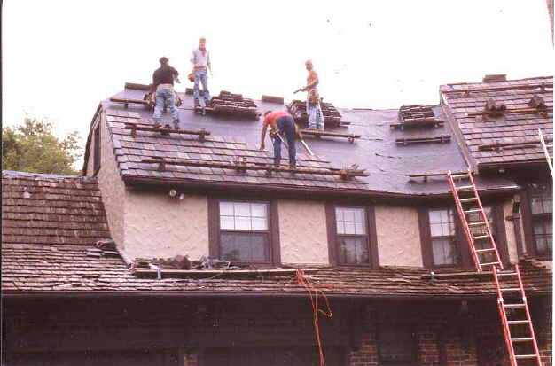
Slate and Tile Roofs
Common defense is that anchorages may damage the roof.
Must Show Infeasibility in Written Plan

Slide 39
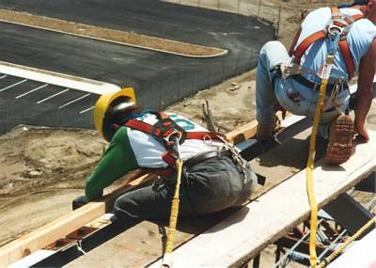
Fall Protection
Notes:
From OSHA fact sheet A fall restraint system may consist of a
full body harness or body belt that is connected
to an anchor point at the center of a roof by a
lanyard of a length that will not allow a worker
to physically reach the edge of the roof.

Slide 40
January 2015
Texas
Roof Fall Protection

Slide 41
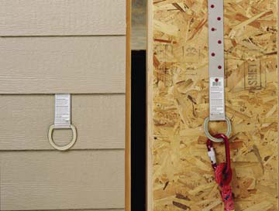
How to Comply

Slide 42
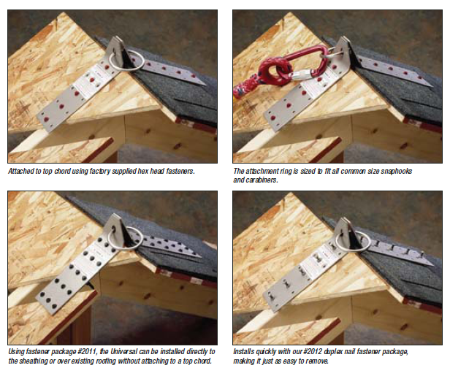
How to Comply

Slide 43
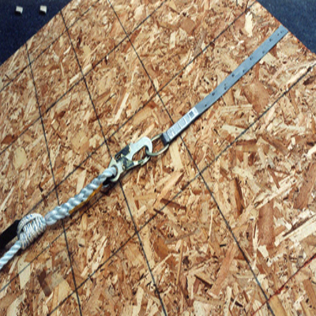
How to Comply

Slide 44
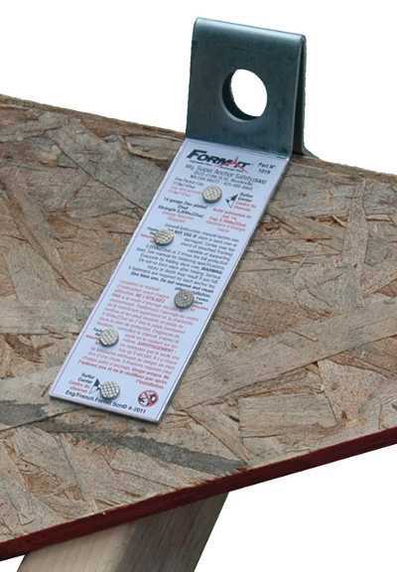
How To Comply

Slide 45
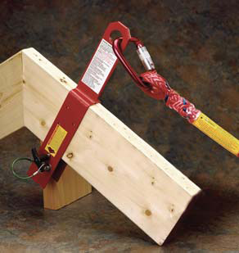
How to Comply

Slide 46
How to Comply

Slide 47
How to Comply

Slide 48
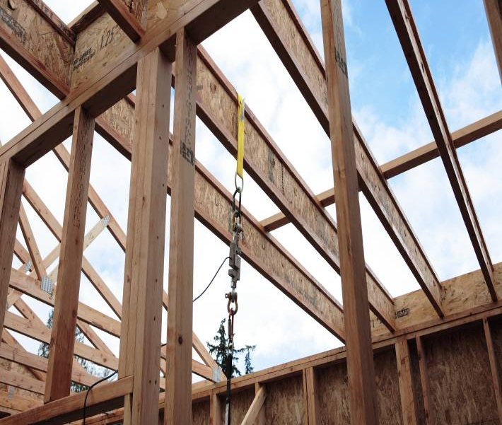
How to Comply

Slide 49
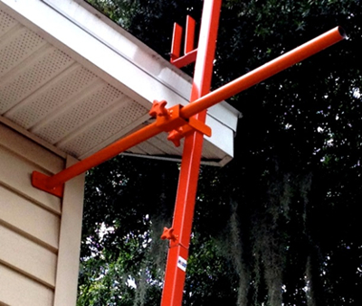
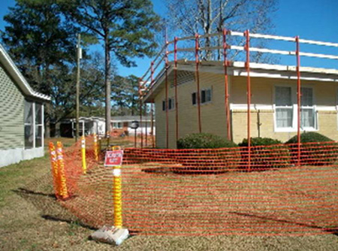
How to Comply

Slide 50
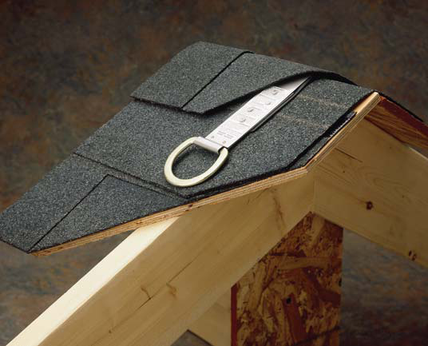
How to Comply

Slide 51


Guardrail Systems
Guardrails in place during re-roofing activities.
Note: The picture on the right lacks protection for the rake edge so some means of protecting this worker (guardrail, safety nets or PFAS) must be used.
Notes:
In this slide we see re-roofing activities being performed behind guardrails.
The picture on the right lacks protection for the rake edge so another means of protecting this worker (safety nets or Personal Fall Arrest System) must be used.

Slide 52

How to Comply

Slide 53

How to Comply

Slide 54


How to Comply

Slide 55

Side Wall Bracket
Notes:
http://www.ot.wustl.edu/FPtech/sidewallstagingbracket.htm

Slide 56

How To Comply

Slide 57


Floor Openings
Many falls through openings were stair openings
Violation: Floor opening with no guardrails.
Notes:
03/02/2005 at 4:46PM Cause of Death: Fall The victim was one of a four man crew framing a two story residential building with a basement. The victim returned from lunch and the crew was on the second floor preparing to start work setting the east interior wall of the bonus room when the victim fell down the stairwell opening 19' 2" to the basement concrete floor. There were no guardrails on three sides of the 10' by 8' stairwell opening.

Slide 58

Open Side Floor Abatement
Floor sheathing abatement using alternative fall protection methods.
No Violation: Area for wall building marked off six feet from edge.

Slide 59


Floor Opening Abatement
Violation: 4' x 8' sheets of plywood covering a stairway opening to the basement of a house. Only four nails hold the two covers. The cover is not marked.
No Violation: Guardrails used

Slide 60

Ladderjack Scaffold
Work is often siding
No fall arrest worn

Slide 61

Ladder Jack Abatement
Fall arrest is often a roof anchorage, rope grab, and body harness.

Slide 62

Rotten Roofs
Roof tear off on old roofs can pose a danger for falling through the roof.

Slide 63

Training
1926.503 (a)(1)
The employer shall provide a training program for each employee who might be exposed to fall hazards. The program shall enable each employee to recognize the hazards of falling and shall train each employee in the procedures to be followed in order to minimize these hazards.
No slide guard or fall protection used

Slide 64
Criminal 2014
US Marshalls take IL trenching contractor to jail.
"A U.S. Marshall has taken an Illinois business owner into custody after the employer failed to correct serious trenching hazards and pay OSHA penalties.
On Oct. 27, the Seventh Circuit Court of Appeals granted a motion filed by Secretary of Labor Thomas E. Perez against the owner of Mike Neri Sewer & Water Contractor Inc., based in Elk Grove Village, Ill.
This action followed the owner's long history of failing to comply with OSHA standards and orders of the independent Occupational Safety and Health Review Commission.
In October 2013, the Court issued an enforcement order against Neri and when he failed to comply, the Court held Neri in contempt in July 2014 and threatened him with possible incarceration.
Last week, after receiving no response from Neri, the Court granted the Secretary's motion to proceed with coercive actions, ordering the U.S. Marshal to place Neri in the custody of the Attorney General.
Neri will remain in custody until a District or Magistrate Judge certifies to the Court that he has either fully complied with the Court's enforcement order or has demonstrated he is unable to comply.

Slide 65
Update
Update to the Neri Criminal trench jail.
He was released from jail December 24 after serving three weeks.
Neri was permanently enjoined from engaging in trenching, excavation, construction or related activities and permanently prohibited from possessing or leasing any construction excavation equipment.
The judges also found that Neri, based on a review of his tax returns and other financial records, was unable to pay the $110,440 fine.
However, the judges said the government ‘‘may continue to pursue collection through an appropriate tribunal

Slide 66

Criminal 2014
Blake Bryant, 14, of Palatka fell from a 71-foot tree after he accidentally cut through his safety harness while working for John Wilkes Tree Service in Middleburg.
15 years in jail (Feb 2015)

Slide 67

Covers
Hold twice the weight
Secured
Marked
Violation: 4' x 8' sheets of plywood covering a stairway opening to the basement of a house. Only four nails hold the two covers. The cover is not marked.
Notes:
Many falls in holes occur in areas that are dimly lit. People have picked up plywood covering a hole and then fall through a hole.

Slide 68

Multiple Deaths
Floor holes
Putting plywood over an opening without marking and securing it is very dangerous.

Slide 69




Skylights
Must cover them if working by them.
Will not hold a person’s weight
Notes:
On 4/14/2010 an employee was dispatched to repair roof leaks at the site. The employees went up on the roof over the truck shop by ladder. The employee was crossing the roof area stepped onto the skylight, which was an old corrugated fiberglass panel and fell through the panel. The decedent fell about 20 ft to the concrete floor in the shop. He was critically injured and was taken off life support later the next day.

Slide 70

Forklifts
No riders
Working on a pallet is very dangerous.
Notes:
Employee #1 (deceased) and EE# 2 had loaded wooden doors into the box. EE# 1 told EE#3- the Operator to lift the box up to the third floor unit and lock the lift in place. EEs# 1 and 2 then walked up to the 3rd floor unit onto the balcony, EE# 1 climbed over the balcony into the box. After passing the first door to EE# 2, EE#1 went to reach for the second door when EE#3 heard wood cracking EE#1 fell from the box 40'ft to the ground below and the box landed on top of the employee before hit the ground.

Slide 71

February 2015
How does this happen?

Slide 72

Nail Guns
Safety to prevent accidental firing
Wear safety glasses
No Horseplay.
Nail embedded in the knee

Slide 73

2013 MI
A 33-year-old Waterford man was hospitalized last week after suffering a serious injury while working on a construction site in White Lake.
According to a report filed with the White Lake Police Department, the man was using a high powered nail gun when it misfired, sending a nail through the corner of the man's eye, and into his brain.
Notes:
http://whitelake.patch.com/articles/man-seriously-injured-when-nail-gun-misfires-into-his-brain

Slide 74


Table Saw
Unguarded table saws.
Guarded table saw.

Slide 75

Issues?

Slide 76

1998 Wearing Fall Arrest

Slide 77

Controlled Access Zones
Alternative methods
Floor joist installation
Erecting Exterior walls
Sheathing
Roof Truss Erection

Slide 78

Top Plate
The worker has to get on the top plate to give leverage and assist the center man with the large truss.
Due to the many configurations of residential designs it will be evaluated on a case by case basis.
Notes:
OSHA Installation Procedures for Roof Truss and Rafter Erection
During the erection and bracing of roof trusses/rafters, conventional fall protection may present a greater hazard to workers. On this job, safety nets, guardrails and personal fall arrest systems will not provide adequate fall protection because the nets will cause the walls to collapse, while there are no suitable attachment or anchorage points for guardrails or personal fall arrest systems.
On this job, requiring workers to use a ladder for the entire installation process will cause a greater hazard because the worker must stand on the ladder with his back or side to the front of the ladder. While erecting the truss or rafter the worker will need both hands to maneuver the truss and therefore cannot hold onto the ladder. In addition, ladders cannot be adequately protected from movement while trusses are being maneuvered into place. Many workers may experience additional fatigue because of the increase in overhead work with heavy materials, which can also lead to a greater hazard.
Exterior scaffolds cannot be utilized on this job because the ground, after recent backfilling, cannot support the scaffolding. In most cases, the erection and dismantling of the scaffold would expose workers to a greater fall hazard than erection of the trusses/rafters.
On all walls eight feet or less, workers will install interior scaffolds along the interior wall below the location where the trusses/rafters will be erected. "Sawhorse" scaffolds constructed of 46 inch sawhorses and 2x10 planks will often allow workers to be elevated high enough to allow for the erection of trusses and rafters without working on the top plate of the wall.
In structures that have walls higher than eight feet and where the use of scaffolds and ladders would create a greater hazard, safe working procedures will be utilized when working on the top plate and will be monitored by the crew supervisor. During all stages of truss/rafter erection the stability of the trusses/rafters will be ensured at all times.
(Your company name here) shall take the following steps to protect workers who are exposed to fall hazards while working from the top plate installing trusses/rafters:
Only the following trained workers will be allowed to work on the top plate during roof truss or rafter installation:
Workers shall have no other duties to perform during truss/rafter erection procedures;
All trusses/rafters will be adequately braced before any worker can use the truss/rafter as a support;
Workers will remain on the top plate using the previously stabilized truss/rafter as a support while other trusses/rafters are being erected;
Workers will leave the area of the secured trusses only when it is necessary to secure another truss/rafter;
The first two trusses/rafters will be set from ladders leaning on side walls at points where the walls can support the weight of the ladder; and
A worker will climb onto the interior top plate via a ladder to secure the peaks of the first two trusses/rafters being set.
The workers responsible for detaching trusses from cranes and/or securing trusses at the peaks traditionally are positioned at the peak of the trusses/rafters. There are also situations where workers securing rafters to ridge beams will be positioned on top of the ridge beam.
(Your company name here) shall take the following steps to protect workers who are exposed to fall hazards while securing trusses/rafters at the peak of the trusses/ridge beam

Slide 79


Wall Walking
Many contractors are using safety devices that attach to the wall to avoid working on the top plate.
Not anticipated to be exempt under fall protection plan.
This is dangerous and other methods can be used.
Work off ladders and scaffolds if possible.
Notes:
We do not want people using a truss as an anchorage unless it has been designed for anticipated fall arrest forces.

Slide 80

Top Plate Scaffold

Slide 81

It Can Be Done

Slide 82

It Can Be Done

Slide 83

It Can Be Done

Slide 84

It Can Be Done

Slide 85

It Can Be Done

Slide 86

It Can Be Done

Slide 87


