Slide 1
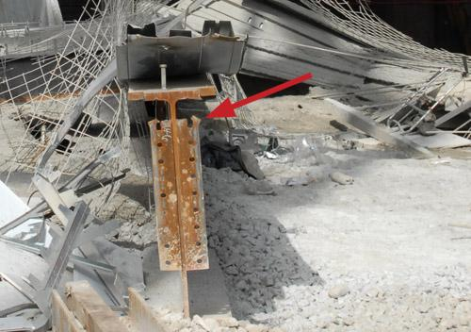
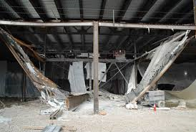
Casino Collapse

Slide 2
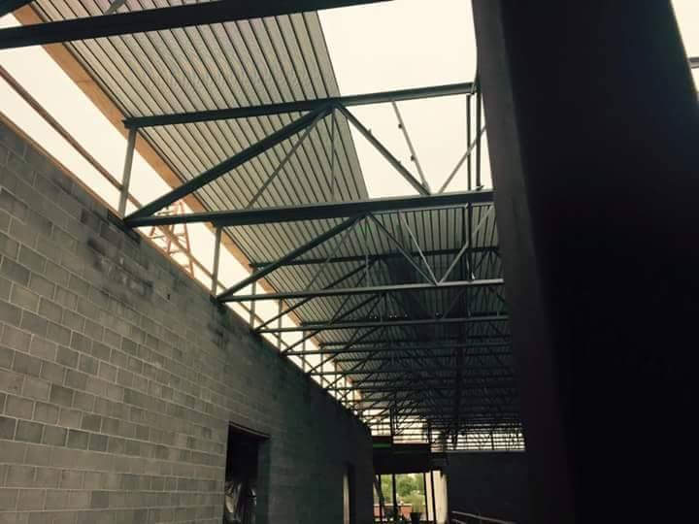
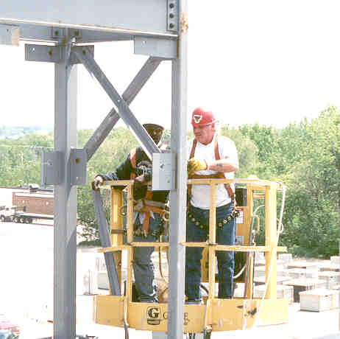
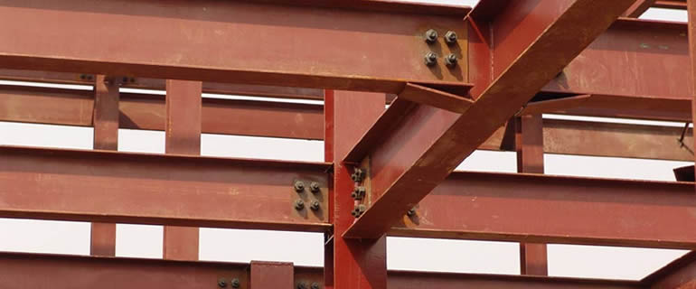
OSHA Steel Erection Standard
Draft 7 15 2019

Slide 3
September 20, 1932
41st Street in Manhattan
RCA building (now called the GE building)

Slide 4
July 2015
Issues?
Photo: Paul Jasinski

Slide 5
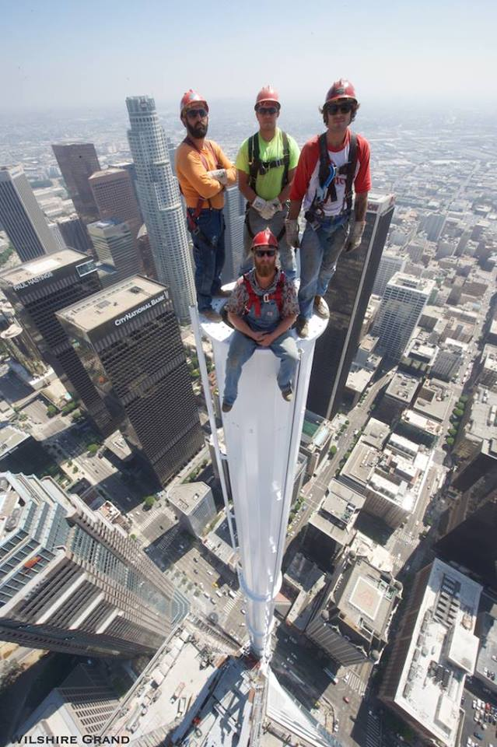
Sep 2016

Slide 6
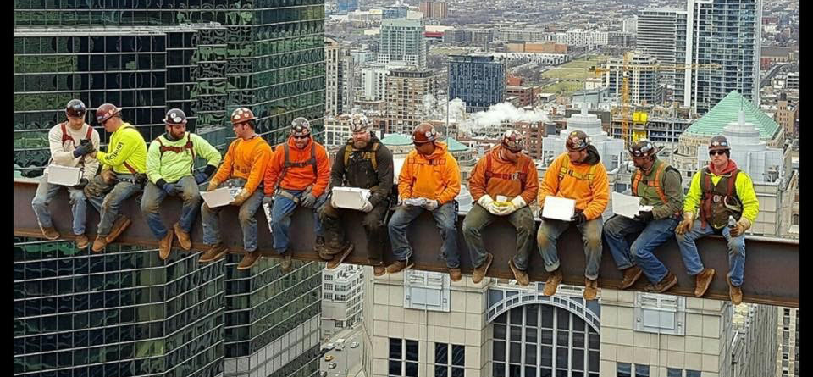
July 2017
151 N. Franklin

Slide 7
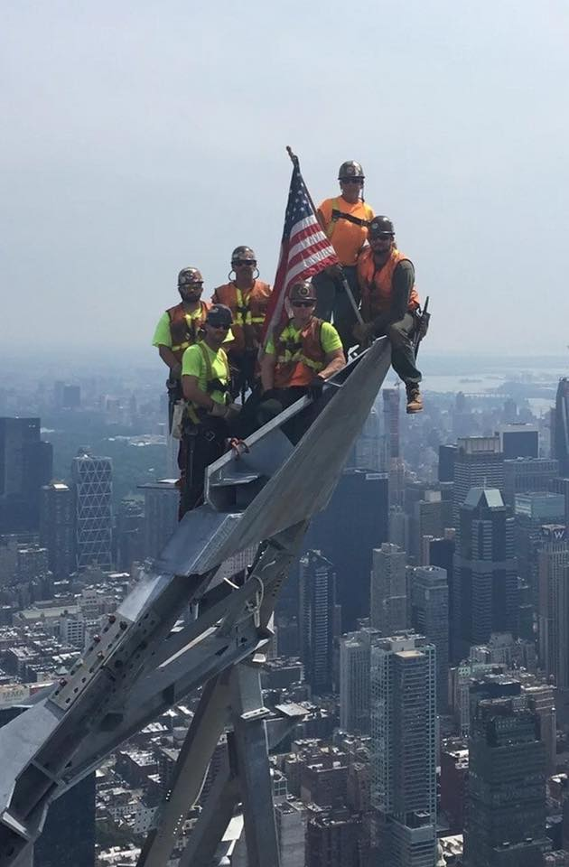
August 2019

Slide 8
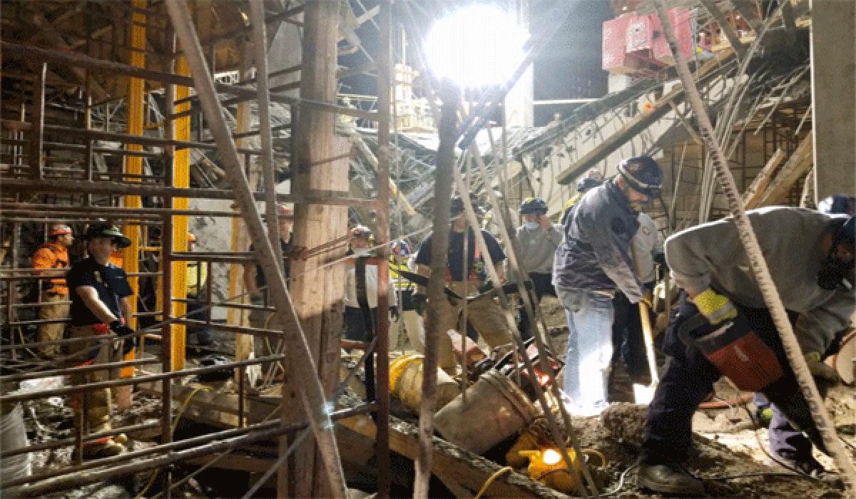
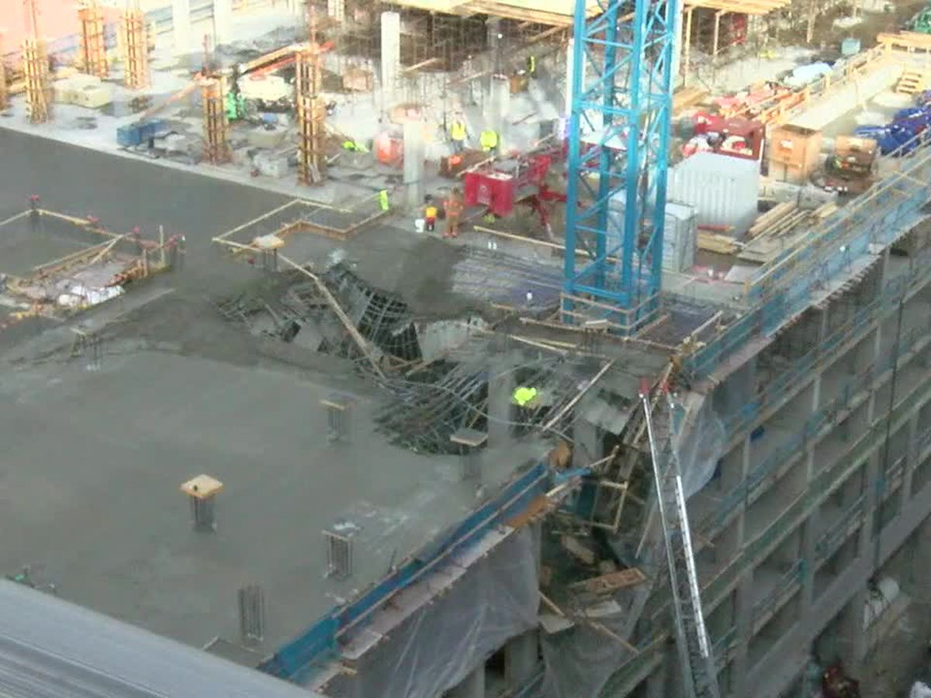
Nov 2019
Cincinnati
Too few bolts connecting horizontal steel support beams with vertical steel columns was the cause of January’s construction accident at Horseshoe Casino Cincinnati, according to the report of the Occupational Safety and Health Administration.
Preston Delph, 58, was on the sixth floor when the seventh floor collapsed.

Slide 9
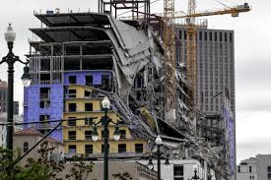
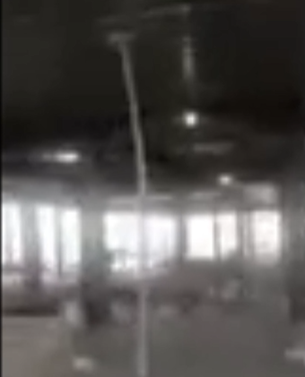
Oct 2019
New Orleans
3 dead

Slide 10
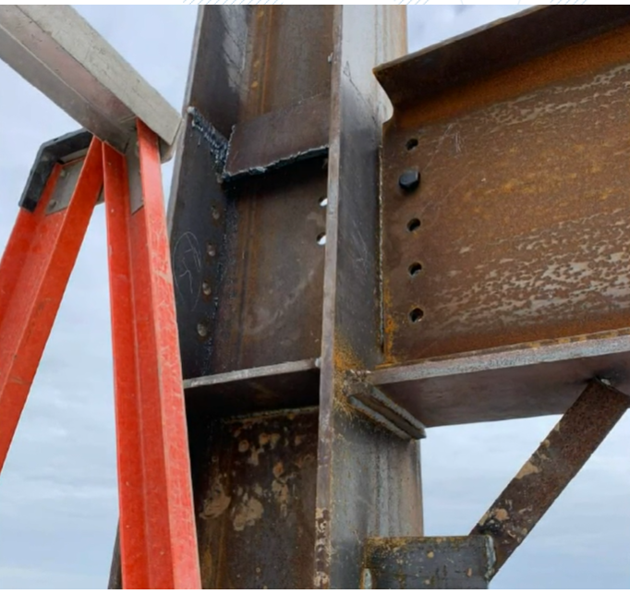
Oct 2019

Slide 11
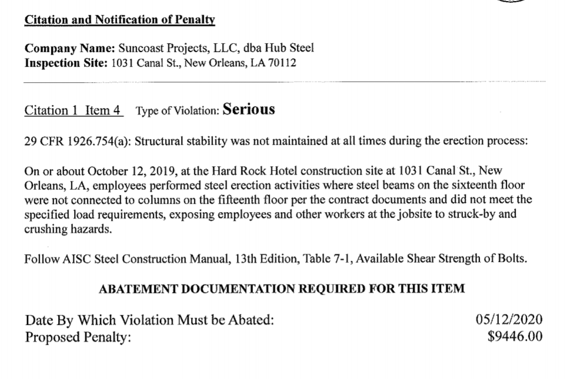
Oct 2019

Slide 12
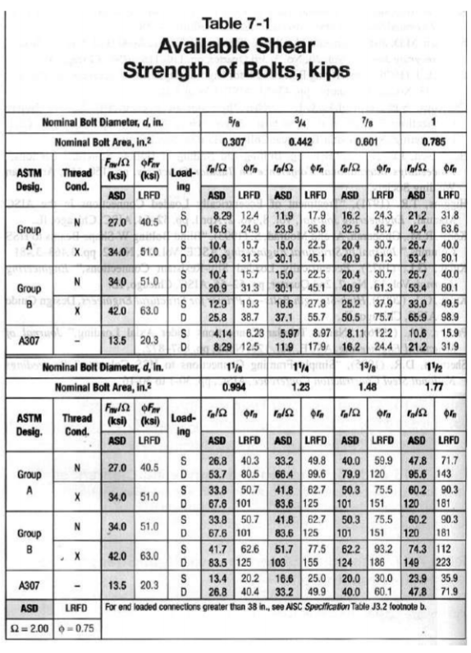
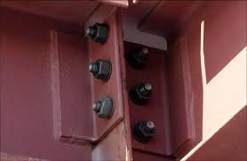
Oct 2019

Slide 13
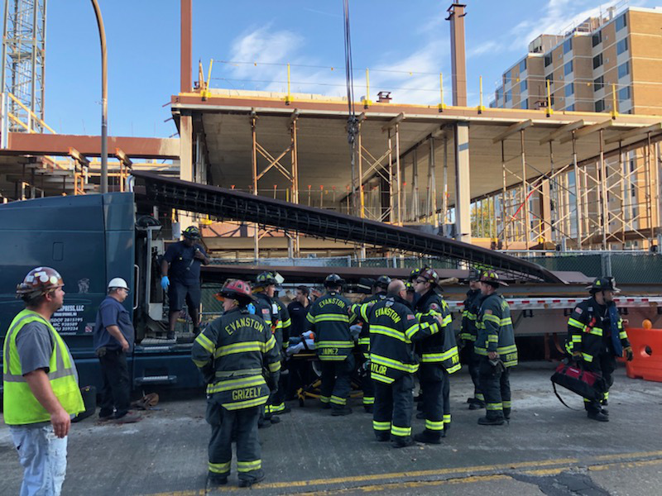
Oct 2018
A crane was lifting beams from a semitrailer Tuesday morning at a nine-story apartment building under construction in Evanston when the beam fell onto the workers.

Slide 14
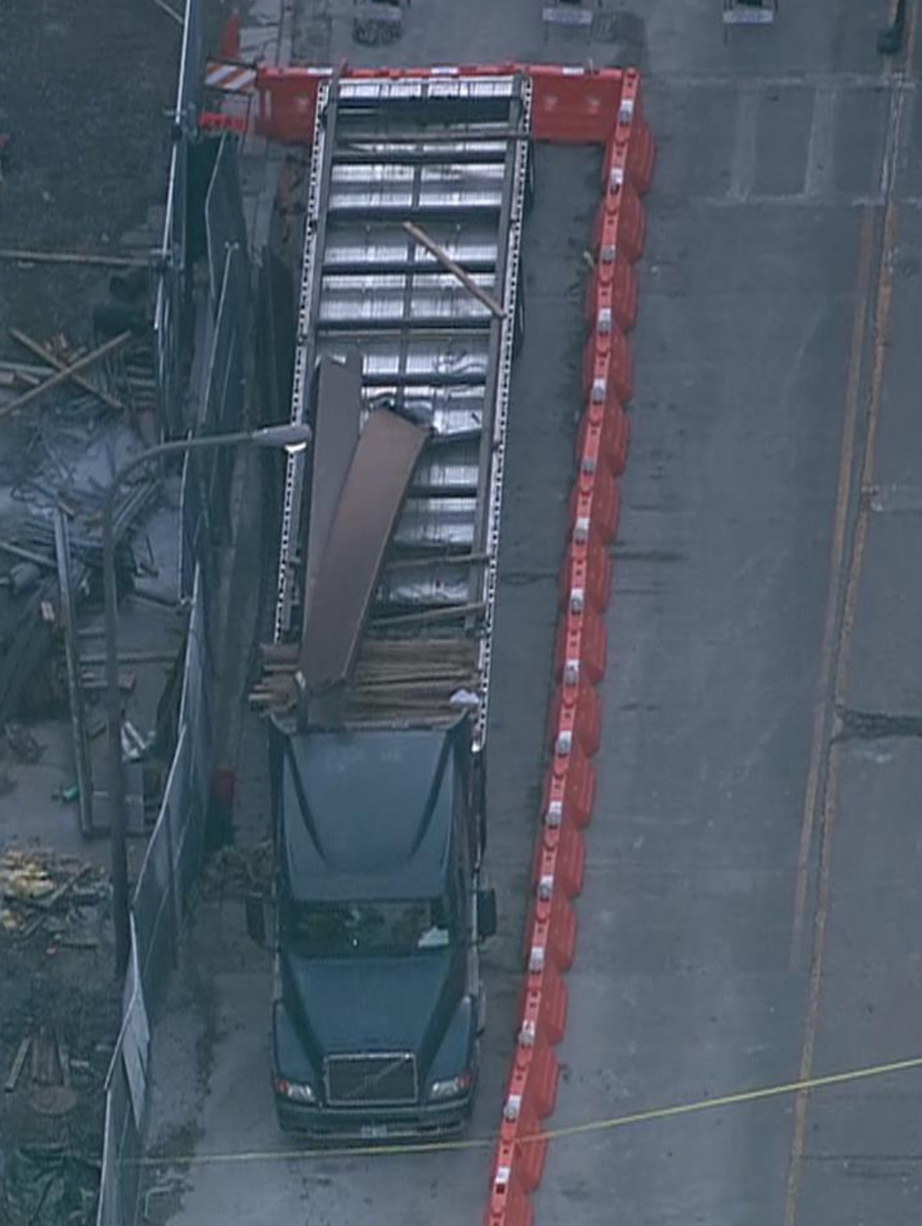
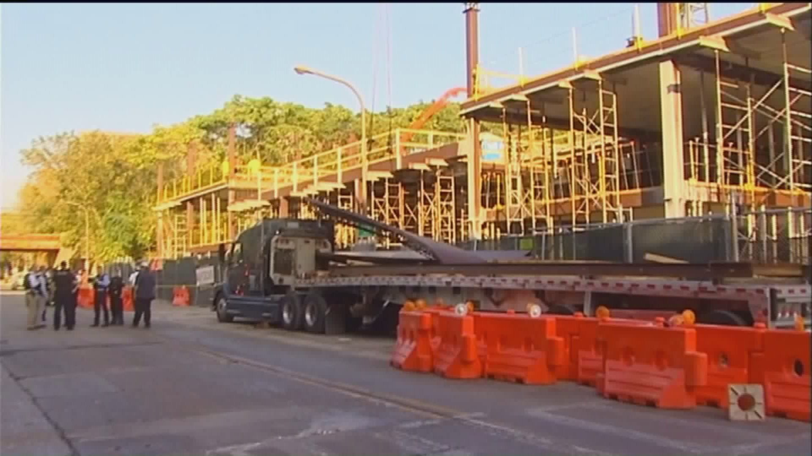
Cont.
"A crane was unloading stabilization columns from the back of a truck when the crane's rigging failed,"

Slide 15
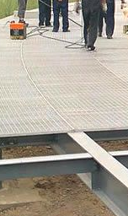
May 2017
Laying grating
Fell 8 feet
Broke vertebra in back

Slide 16
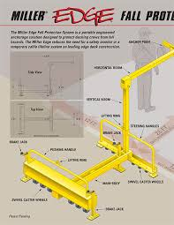
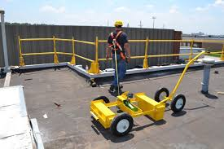
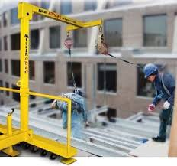
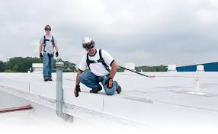
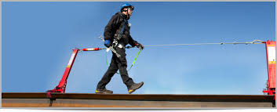
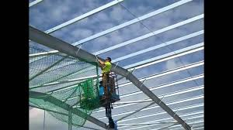
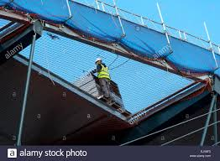
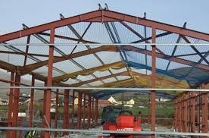
Leading Edge

Slide 17
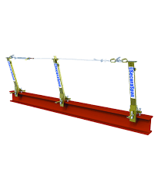
Mar 2018

Slide 18
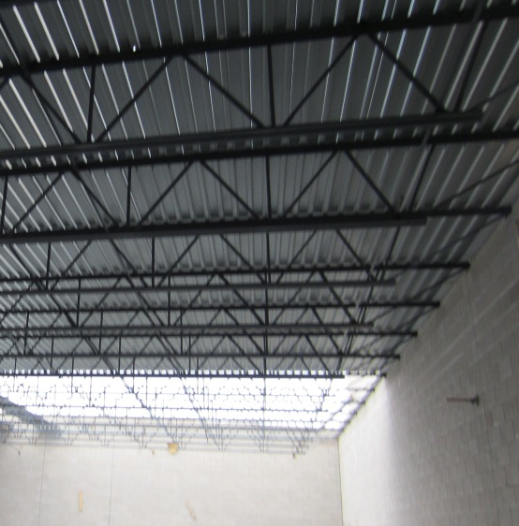
May 2017
According to Wilmington police, the 44-year-old ironworker was working on the warehouse roof when he fell to his death in Wilmington
Notes:
at approximately 8:30 a.m.
http://www.daily-journal.com/news/local/bourbonnais-ironworker-falls-to-death-in-wilmington/article_fe4c0004-d01d-5582-b737-4b8e9543fcb9.html

Slide 19
May 2016
Photo Joe Castro - TX

Slide 20
December 2015
South Chicago Heights
Employee 1 was operating a Powered Industrial Vehicle (forklift) while lifting a steel column using a nylon strap.
As employee 1 was lifting the column, the strap broke causing the column to strike employee 2.
Employee 2 was fatally injured as a result of the incident.
Lifting with a forklift and fiber slings is dangerous.

Slide 21
July 2015
Photo: Chris Markum - Oklahoma

Slide 22
May 2015

Slide 23
Quebec Bridge Disaster
August 9, 1907
50 ironworkers and 36 other workers were killed.
20,000 ton sector fell.
Cantilever beams buckled.
Ironworkers expected to only work 10 years before death or serious injury.

Slide 24
Golden Gate Bridge
11 workers died.
Installed first safety net on a bridge.
19 workers saved.

Slide 25
State of Illinois Building
December 11, 1981
3 Ironworkers and 2 others died in 100 foot fall.
¾ lifting bar failed.
“Heard a pop.”
$8500 penalty by OSHA.
Name at least five requirements before riding in a suspended platform.
Notes:
Kafka said there were about five fatalities in construction of the State of Illinois Building and four at Sears Tower
http://news.google.com/newspapers?nid=1842&dat=19811212&id=G2EeAAAAIBAJ&sjid=eMgEAAAAIBAJ&pg=1220,2779891

Slide 26
US Post Office Collapse
Chicago, IL
November 3, 1993
3 workers died
U.S. Court of Appeals Seventh Circuit affirmed that (PDM) was willfully in violation of the OSHA Act. The conviction and $1 million penalty were affirmed.
Changes in fabrication made the use of the one-inch diameter bolts impossible. Had to switch to ¾-inch diameter bolts.
Notes:
On February 18, the U.S. Court of Appeals for the Seventh Circuit (Chicago - No 98-1767)) affirmed that Pitt-Des Moines (PDM) was willfully in violation of the OSHA Act. The ruling was in the case of the 1993 steel structure collapse of the post office project in downtown Chicago. The conviction and $1 million penalty were affirmed
Changes made by the fabricator, solely for ease of erection, resulted in the beams being placed one quarter inch further away from the columns than required. This change made the use of the one inch diameter bolts impossible. Instead, workers had to switch to using three quarter inch bolts to secure the beams. The change in hardware led to a series of weak connections, some without nuts to secure the bolts. The location where the collapse began, unsurprisingly, was a connection where a nut was not used.

Slide 27
Workshop
Roof Collapse
Site GC onsite daily
Seat failed due to Inadequate Design by Engineering company
Ironworker not two bolt as required
Who is cited?

Slide 28
1926.105(a)
Safety nets shall be provided when workplaces are more than 25 feet above the ground or water surface, or other surfaces where the use of ladders, scaffolds, catch platforms, temporary floors, safety lines, or safety belts is impractical.

Slide 29
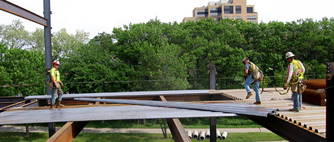
Need for a Standard
1996 was the worst year for ironworker fatalities since 1987.
That year, 49 ironworkers died.
That was huge jump from 1995's 35 deaths.
In 1987, there were 53 deaths.
Falls accounted for 38 out 49 fatalities.
Metal decking was the activity that resulted in the most fall deaths.
Many were below the OSHA requirements for fall protection of 25 feet
Notes:
1 26 m 7/29/96 fell unknown height in a water tower - welder
2 31 m 8/5/96 welder fell when an unsecured beam dropped 10 feet
3 34 m 8/9/96 fell while doing leading edge metal decking 28'
4 38 m 8/23/96 welder fell when hit by crane load - unknown height
5 27 m 8/29/96 fell when sliding a roof curb into place - unknown height
6 54 m 9/10/96 fell while metal roof decking 16'
7 38 m 9/18/96 contacted power line on a roof
8 33 m 9/23/96 fell while laying steel decking - 25'
9 23 m 12/9/96 erector struck by collapsing precast wall during erection
10 39 m 12/12/96 connector fell off a steel beam - 19'
11 43 m 11/15/96 fell when crane load hit a joist - 12'
12 36 m 11/9/96 fell while positioning steel plate - 65'
13 40 m 10/28/96 fell off an unknown scaffold - 13'
14 55 m 10/22/96 welder fell from a roof - unknown height
15 26 m 10/8/96 working from bridge removing stringers - fell 80'
16 37 m 10/07/96 fell through roof opening while moving hole cover - 25'
17 63 m 10/5/96 fell when a scaffold hit by crane load - 50'
18 49 m 9/26/96 fell while metal decking on a roof - unknown height
19 55 m 9/24/96 fell while metal decking -20'
20 46 m 1/10/96 struck by crane boom during pin removal
21 48 m 1/28/96 fell while metal roof decking - 20'
22 32 m 2/7/96 fell while working on a roof - 16'
23 45 m 2/10/96 fell while metal roof decking 32'
24 27 m 2/29/96 crushed between truss and column during erection
25 28 m 3/19/96 fell when hit by falling rebar - 30'
26 51 m 3/20/96 fell off a concrete barrier into traffic and run over
27 43 m 4/9/96 crushed when aerial lift pinned between basket and beam
28 42 m 4/17/96 struck by falling tower ladder
29 41 m 5/1/96 fell through opening after removed cover - 22'
30 32 m 5/3/96 fell from a communication tower - unknown height
31 31 m 5/8/96 fell while metal decking - 36' - fall arrest system failed
32 40 m 5/14/96 unknown fall - found at base of a 30' ladder
33 33 m 5/22/96 fell while trying to land a bundle of decking - 25'
34 34 m 5/29/96 flammable liquid sump compartment exploded during torch cutting
35 43 m 5/29/96 fall from a steel beam - unknown height
36 54 m 6/7/96 fell when stepped on unsecured metal decking - 19'
37 23 m 6/12/96 fell when sliding down a column - 32'
38 57 m 6/18/96 precast erector crushed by panel that slid off bearing pad
39 29 m 6/19/96 fell while removing metal guardrails - unknown height
40 42 m 6/26/96 fell when unsecured decking gave way - 42'
41 42 m 6/28/96 fell off a beam when tripped on a flange - 15'
42 29 m 7/1/97 fall from a roof - unknown height
43 42 m 7/19/96 struck by welded paddeye when it came loose when pulled by a come-a-long
44 32 m 11/11/96 Lost grip and fell while climbing a column - 20'
45 38 m 4/27/96 fell through floor opening on a roof - unknown height
46 40 m 4/3/96 fell while removing sheet metal in preparation for metal decking - 25'
47 32 m 2/27/96 fell during precast panel erection - 209'
48 38 m 1/17/96 hooking slings up when crane wire rope hit power line
49 39 m 12/4/96 slipped off a steel beam - 19'

Slide 30
Final Rule
Published: January 18, 2001.
Effective Date: January 18, 2002.
Painted Surface Provision 2006.

Slide 31
Highlights of the New Standard
Ironworkers welding at the edge of the deck opening, using the cables as a fall arrest system.
Notes:
1 26 m 7/29/96 fell unknown height in a water tower - welder
2 31 m 8/5/96 welder fell when an unsecured beam dropped 10 feet
3 34 m 8/9/96 fell while doing leading edge metal decking 28'
4 38 m 8/23/96 welder fell when hit by crane load - unknown height
5 27 m 8/29/96 fell when sliding a roof curb into place - unknown height
6 54 m 9/10/96 fell while metal roof decking 16'
7 38 m 9/18/96 contacted power line on a roof
8 33 m 9/23/96 fell while laying steel decking - 25'
9 23 m 12/9/96 erector struck by collapsing precast wall during erection
10 39 m 12/12/96 connector fell off a steel beam - 19'
11 43 m 11/15/96 fell when crane load hit a joist - 12'
12 36 m 11/9/96 fell while positioning steel plate - 65'
13 40 m 10/28/96 fell off an unknown scaffold - 13'
14 55 m 10/22/96 welder fell from a roof - unknown height
15 26 m 10/8/96 working from bridge removing stringers - fell 80'
16 37 m 10/07/96 fell through roof opening while moving hole cover - 25'
17 63 m 10/5/96 fell when a scaffold hit by crane load - 50'
18 49 m 9/26/96 fell while metal decking on a roof - unknown height
19 55 m 9/24/96 fell while metal decking -20'
20 46 m 1/10/96 struck by crane boom during pin removal
21 48 m 1/28/96 fell while metal roof decking - 20'
22 32 m 2/7/96 fell while working on a roof - 16'
23 45 m 2/10/96 fell while metal roof decking 32'
24 27 m 2/29/96 crushed between truss and column during erection
25 28 m 3/19/96 fell when hit by falling rebar - 30'
26 51 m 3/20/96 fell off a concrete barrier into traffic and run over
27 43 m 4/9/96 crushed when aerial lift pinned between basket and beam
28 42 m 4/17/96 struck by falling tower ladder
29 41 m 5/1/96 fell through opening after removed cover - 22'
30 32 m 5/3/96 fell from a communication tower - unknown height
31 31 m 5/8/96 fell while metal decking - 36' - fall arrest system failed
32 40 m 5/14/96 unknown fall - found at base of a 30' ladder
33 33 m 5/22/96 fell while trying to land a bundle of decking - 25'
34 34 m 5/29/96 flammable liquid sump compartment exploded during torch cutting
35 43 m 5/29/96 fall from a steel beam - unknown height
36 54 m 6/7/96 fell when stepped on unsecured metal decking - 19'
37 23 m 6/12/96 fell when sliding down a column - 32'
38 57 m 6/18/96 precast erector crushed by panel that slid off bearing pad
39 29 m 6/19/96 fell while removing metal guardrails - unknown height
40 42 m 6/26/96 fell when unsecured decking gave way - 42'
41 42 m 6/28/96 fell off a beam when tripped on a flange - 15'
42 29 m 7/1/97 fall from a roof - unknown height
43 42 m 7/19/96 struck by welded paddeye when it came loose when pulled by a come-a-long
44 32 m 11/11/96 Lost grip and fell while climbing a column - 20'
45 38 m 4/27/96 fell through floor opening on a roof - unknown height
46 40 m 4/3/96 fell while removing sheet metal in preparation for metal decking - 25'
47 32 m 2/27/96 fell during precast panel erection - 209'
48 38 m 1/17/96 hooking slings up when crane wire rope hit power line
49 39 m 12/4/96 slipped off a steel beam - 19'

Slide 32
Table of Contents
Definitions § 1926.751
Site Preparation § 1926.752 Site Layout and Construction Sequence
Cranes § 1926.753 Hoisting and Rigging
Structural Stability § 1926.754 Structural Steel Assembly § 1926.755 Column Anchorage § 1926.756 Beams and Columns § 1926.757 Open Web Steel Joists
Metal Buildings § 1926.758 Systems-engineered Metal Buildings
(Non-Hoist) Overhead Hazards § 1926.759 Falling Object Protection
Fall Protection § 1926.760 Fall Protection (for connectors, deckers, and all others)
Training § 1926.761 Training (general and specialized)
Notes:
1 26 m 7/29/96 fell unknown height in a water tower - welder
2 31 m 8/5/96 welder fell when an unsecured beam dropped 10 feet
3 34 m 8/9/96 fell while doing leading edge metal decking 28'
4 38 m 8/23/96 welder fell when hit by crane load - unknown height
5 27 m 8/29/96 fell when sliding a roof curb into place - unknown height
6 54 m 9/10/96 fell while metal roof decking 16'
7 38 m 9/18/96 contacted power line on a roof
8 33 m 9/23/96 fell while laying steel decking - 25'
9 23 m 12/9/96 erector struck by collapsing precast wall during erection
10 39 m 12/12/96 connector fell off a steel beam - 19'
11 43 m 11/15/96 fell when crane load hit a joist - 12'
12 36 m 11/9/96 fell while positioning steel plate - 65'
13 40 m 10/28/96 fell off an unknown scaffold - 13'
14 55 m 10/22/96 welder fell from a roof - unknown height
15 26 m 10/8/96 working from bridge removing stringers - fell 80'
16 37 m 10/07/96 fell through roof opening while moving hole cover - 25'
17 63 m 10/5/96 fell when a scaffold hit by crane load - 50'
18 49 m 9/26/96 fell while metal decking on a roof - unknown height
19 55 m 9/24/96 fell while metal decking -20'
20 46 m 1/10/96 struck by crane boom during pin removal
21 48 m 1/28/96 fell while metal roof decking - 20'
22 32 m 2/7/96 fell while working on a roof - 16'
23 45 m 2/10/96 fell while metal roof decking 32'
24 27 m 2/29/96 crushed between truss and column during erection
25 28 m 3/19/96 fell when hit by falling rebar - 30'
26 51 m 3/20/96 fell off a concrete barrier into traffic and run over
27 43 m 4/9/96 crushed when aerial lift pinned between basket and beam
28 42 m 4/17/96 struck by falling tower ladder
29 41 m 5/1/96 fell through opening after removed cover - 22'
30 32 m 5/3/96 fell from a communication tower - unknown height
31 31 m 5/8/96 fell while metal decking - 36' - fall arrest system failed
32 40 m 5/14/96 unknown fall - found at base of a 30' ladder
33 33 m 5/22/96 fell while trying to land a bundle of decking - 25'
34 34 m 5/29/96 flammable liquid sump compartment exploded during torch cutting
35 43 m 5/29/96 fall from a steel beam - unknown height
36 54 m 6/7/96 fell when stepped on unsecured metal decking - 19'
37 23 m 6/12/96 fell when sliding down a column - 32'
38 57 m 6/18/96 precast erector crushed by panel that slid off bearing pad
39 29 m 6/19/96 fell while removing metal guardrails - unknown height
40 42 m 6/26/96 fell when unsecured decking gave way - 42'
41 42 m 6/28/96 fell off a beam when tripped on a flange - 15'
42 29 m 7/1/97 fall from a roof - unknown height
43 42 m 7/19/96 struck by welded paddeye when it came loose when pulled by a come-a-long
44 32 m 11/11/96 Lost grip and fell while climbing a column - 20'
45 38 m 4/27/96 fell through floor opening on a roof - unknown height
46 40 m 4/3/96 fell while removing sheet metal in preparation for metal decking - 25'
47 32 m 2/27/96 fell during precast panel erection - 209'
48 38 m 1/17/96 hooking slings up when crane wire rope hit power line
49 39 m 12/4/96 slipped off a steel beam - 19'

Slide 33
§ 1926.750 Scope
The standard covers all employers engaged in steel erection activities.
Two lists of activities:
Primary: all activities in .750 (b)(1) are covered (connecting, bracing, guying…)
Ancillary: all listed in .750 (b)(2) are covered when they occur during and are a part of steel erection activities (sealing, caulking, elevator beams…)

Slide 34
§ 1926.750 Scope
Does not include:
electrical transmission towers;
communication and broadcast towers;
tanks.
Ironworker using rope grabs to make tower connection.

Slide 35
§ 1926.750(c) Specific Controlling Contractor Duties
Written notification to the steel erector:
Concrete in piers/walls is cured re ASTM spec.
Anchor bolt modifications/repairs approved by project engineer (.752(a); .755(b)).
Adequate on-site access roads (.752(c)).
Before and after photos.

Slide 36
Access (continued)
Aerial lifts must be used on firm surfaces.
Only parts of the job were graded.

Slide 37
Controlling Contractor Duties
Preclude work below steel erection unless there is overhead protection 1926.759(b)

Slide 38
Controlling Contractors
Controlling contractors will also have to choose whether or not to accept and take custody of fall protection systems.
1926.760(e)
Electric wire is not acceptable as a guardrail - Batavia, IL.

Slide 39
§ 1926.752 Site Layout, Construction Plan, and Erection Sequence
Certification of:
proper curing of concrete in footings, piers, etc for steel columns.
anchor bolt repairs, modifications.
Pre-plan hoisting operations.

Slide 40
§ 1926.752 Hoisting and Rigging
Qualified rigger to inspect rigging before each shift.
Quick release device for hoisting columns.
Pin must be able to lift the column with a safety factor of 6, similar to a sling.

Slide 41
2000

Slide 42
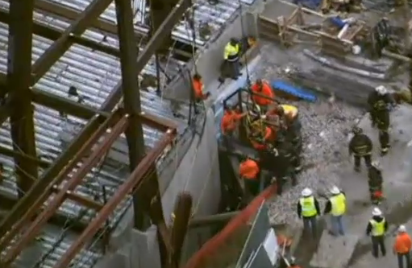
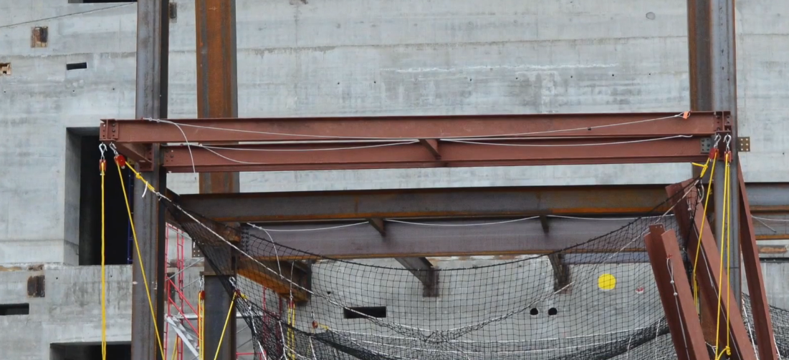
December 2014
The Fire Department said four people were injured when a steel I-beam came down at a construction site around 9:15am at the northeast corner of Lake and Canal streets, on the west bank of the Chicago River.

Slide 43
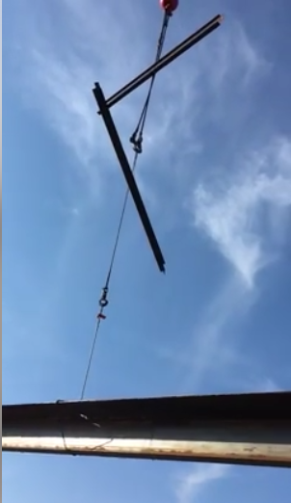
Multiple Lifts
§ 1926.753
Maximum of 5 pieces
Similar pieces (no deck bundles)
Trained rigger
Crane manufacturer must not prohibit it
7 foot spacing

Slide 44
Lambeau Field

Slide 45
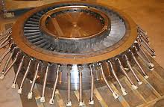
March 2013
Lawsuit against CA company contracted to design and operate a gantry crane that would lift and move the 600-ton stator at AR nuke plant.
While the stator was suspended, the lifting device failed and caused the gantry to collapse, dropping the stator approximately 30 feet. It killed 24-year-old ironworker Wade C. Walters and knocked the plant's Unit 2 offline.
Gantry's safe lifting capacity was 577 tons.
Notes:
http://www.couriernews.com/view/full_story/23189349/article-Entergy-sues-contractors-for-ANO-accident?instance=top_news

Slide 46
§ 1926.754 Structural Steel Assembly
No securement or marking to indicate the opening.
Cover marked and secured.
Covers for floor or roof openings shall be secured and marked with the word HOLE or COVER.

Slide 47
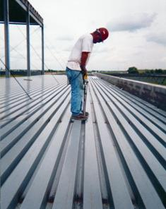
Dekalb
$12,434,000 settlement for an ironworker and his wife after the worker suffered a brain injury from a fall of 18 feet after a defective piece of roof decking shifted during installation at a car dealership.
“I had to pay $250,000 out of my pocket.”

Slide 48
§ 1926.754 Structural Steel Assembly
Holes and openings shall be decked over or have employees protected per 760.
Opening in decking netted to comply with 1926.760(b).

Slide 49
§ 1926.755 Column Anchorage
Requires 4 anchor bolts per column:
contains design strength requirements and other column stability requirements.
Assure the adequacy of anchor bolts modified in the field.
Column would not align with the j-bolts, so the steel erector cut holes and welded tabs to hold column.

Slide 50
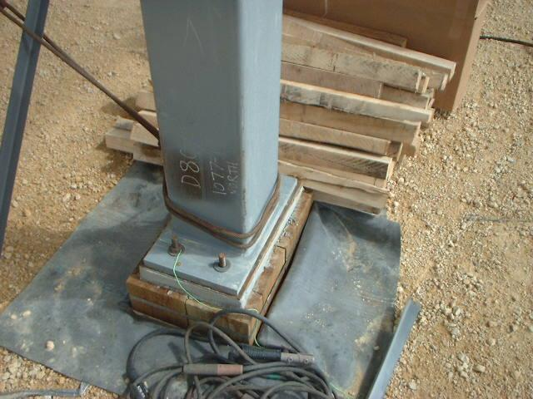
Column Anchorage
Four bolts used
Missing two nuts

Slide 51
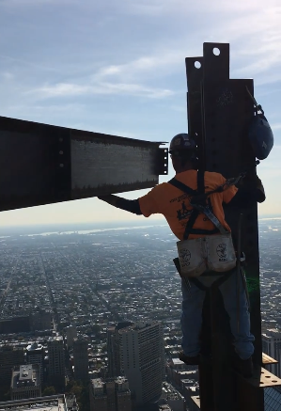
§ 1926.756 Beams and Columns
Two bolts per connection prior to releasing hoisting line.
One bolt is installed wrench tight. Two will be installed.
The spud wrench holds the beam until the other connector can make his initial connection.

Slide 52
July 2013
300-foot barn that was under construction as part of the $80 million Equine Complex.
The steel frame structure fell when a worker released a rafter from a crane before proper bracing was completed.
Once the rafter was let go, "the building racked and fell to the ground," according to OSHA documents.
Ramco Erectors also cited for failing to instruct employees on unsafe conditions.

Slide 53
§ 1926.756 Beams and Columns
Requirements to facilitate quick installation of perimeter safety cables:
Perimeter columns extend 48 inches;
Have holes or other devices for perimeter cable;
Feasibility exception in app F.

Slide 54
§ 1926.756 Beams and Columns
Requires one bolt to remain connected for double connections unless seat or equivalent used.
Seats for double connections shall be designed for the load during the double connection process.

Slide 55
$64 Million
December 2007: Ronald Bayer, age 36, sued Panduit on for negligence, claiming to have been severely injured (paralyzed) in a workplace.
Plaintiff claimed that studs placed in iron beams he was walking on caused him to trip, and proper harnessing equipment to prevent the fall had not been installed.
November 2012: The jury, however, ruled that Panduit was 80 percent responsible for the accident, and Bayer was only 20 percent responsible.
Notes:
http://www.morelaw.com/verdicts/case.asp?n=&s=IL&d=58095
http://tinleypark.patch.com/groups/police-and-fire/p/report-panduit-loses-record-64m-suit-over-fall-that-pb0d75c4806

Slide 56
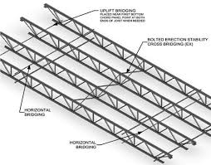
§ 1926.757 Open Web Steel Joists
Erection bridging depends on joist type.
May be allowed as low as 23 feet and as high as 60 feet in certain beams.

Slide 57
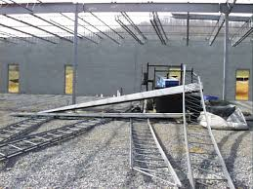
1926.757
Decking Bundles
The bundle of decking is placed on a minimum of three steel joists;
At least one row of bridging is installed and anchored;
The edge of the construction load shall be placed within 1 foot (.30 m) of the bearing surface of the joist end

Slide 58
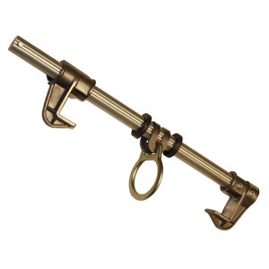
July 2014
Using a Beemer style of fall protection.
Free fall distance is over 6 feet, so manufacturer must approve design and fall arrest system.
Many connect out of aerial lifts or use horizontal lifelines.

Slide 59
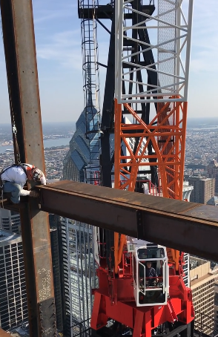
§ 1926.760 Fall Protection
Between 15 and 30 feet, fall protection required for all except:
Deckers in controlled decking zone (CDZ)
Connectors
Connectors must be provided and wear equipment necessary to be tied-off, or be provided with other means of fall protection.

Slide 60
2011
Malta, IL
Connecting out of aerial lifts.
Horizontal lifelines used also.

Slide 61
March 2015
What hazard is there with using this lanyard?

Slide 62
Fabric Lanyards
Cannot be used on sharp edges.
ANSI Z359

Slide 63
October 2014
Many jobs can be connected out of aerial lifts.

Slide 64
§ 1926.760 Fall Protection
Perimeter cables required:
must be installed “as soon as the metal decking has been installed.”

Slide 65
§ 1926.760 Fall Protection
Custody of Fall Protection Equipment:
Controlling contractor must choose to EITHER
accept responsibility for maintaining fall protection equipment left be erector, OR
ensure that it is removed (.760(e)).
Perimeter cable system

Slide 66
Decking
Deckers must use fall protection above 30 feet.
Between 15 and 30 feet, a controlled decking zone could be used.
The Retractable lanyard must be LE (or Leading Edge).
Use of a fall arrest cable parallel with leading edge set back behind the decker is the most common method in IL.

Slide 67
Bridges
Fall Protection is most commonly done by fall arrest systems.
The vertical component is offset to allow walkthrough.
Workers use a double lanyard system.

Slide 68
May 2015
Amesbury, MA bridge‏

Slide 69
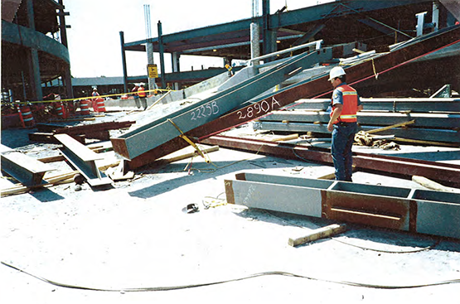
Temporary Bracing
Three union Iron Workers were killed July 31 when a 150-foot section of a seven-story parking garage under construction at Portland International Airport collapsed.
The steel erector failed to provide temporary bracing and guys to the erected steel columns to secure them against any lateral load due to wind and/or any incidental construction load.

Slide 70
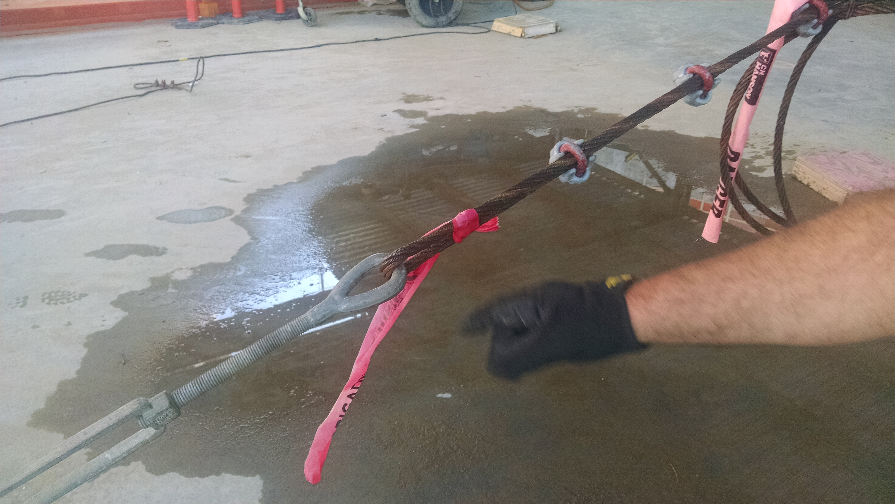
Columns
Columns evaluated whether guying and bracing needed
1926.755(a)(4)

Slide 71
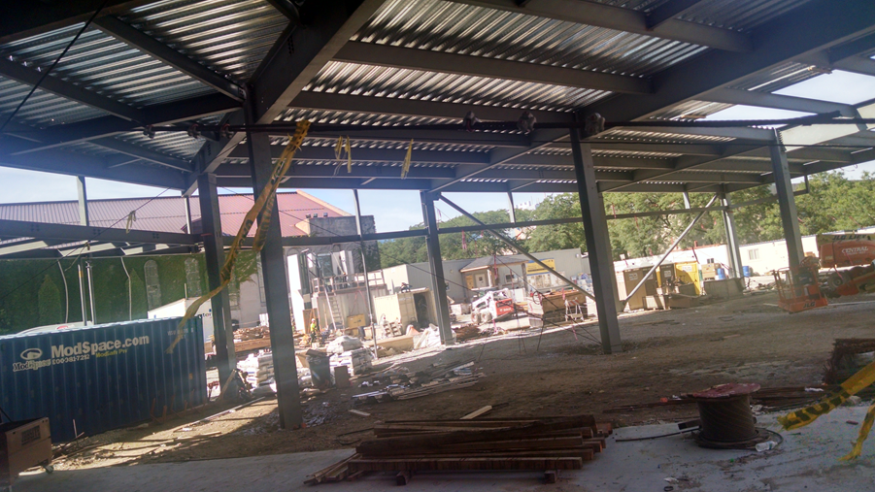
Bracing

Slide 72
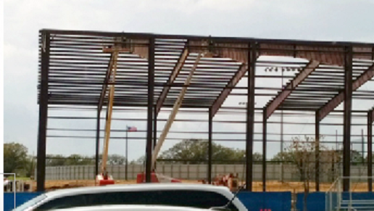
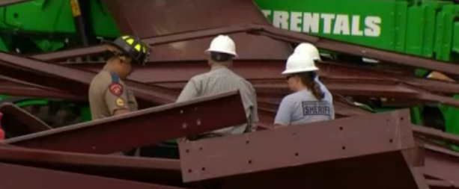
April 2015
Argyle, TX
One killed, several hurt.
Gusts 30 mph.
Wright said the Northstar Builders Group was responsible for the construction, which is part of a $45-million bond package that includes new tennis courts and new turf for the athletic fields.

Slide 73
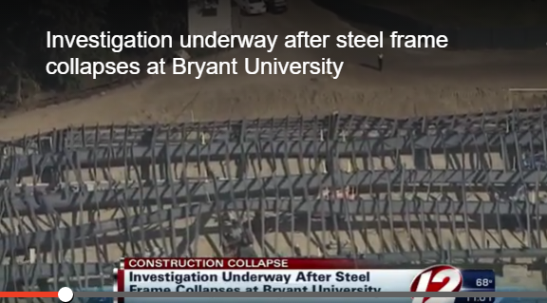
September 2015
Smithfield, RI
6 injured

Slide 74
Struck By
February 2011
Employee # 1 was killed when the entire western cantilevered bay of the steel canopy structure collapsed and one of its steel members struck him.
The steel beam was a component of a steel canopy structure that consisted of three bays: a western cantilevered bay, a center bay and an eastern cantilevered bay.
The shoring towers were inappropriately placed and the stability of the structure was compromised.

Slide 75
§ 1926.761 Training
Qualified person to train workers in use and operation of fall protection equipment.
Qualified person to train workers in specific activities:
“Christmas-treeing”
connecting
CDZ procedures

Slide 76
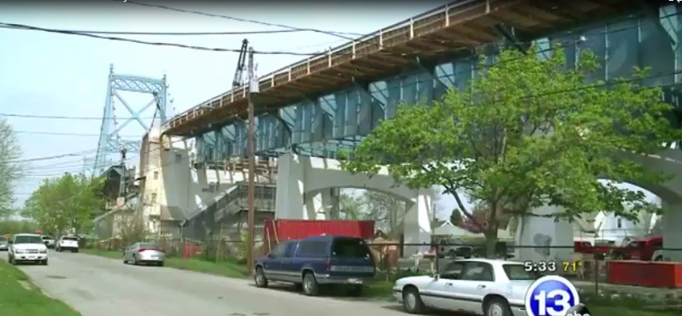
May 2015
Toledo, OH
40 foot fall
Notman has 4 fractured vertebrae, a fractured pelvis, multiple broken bones in his arm and hand, along with a shattered elbow.

Slide 77
The Future?

