Slide 1
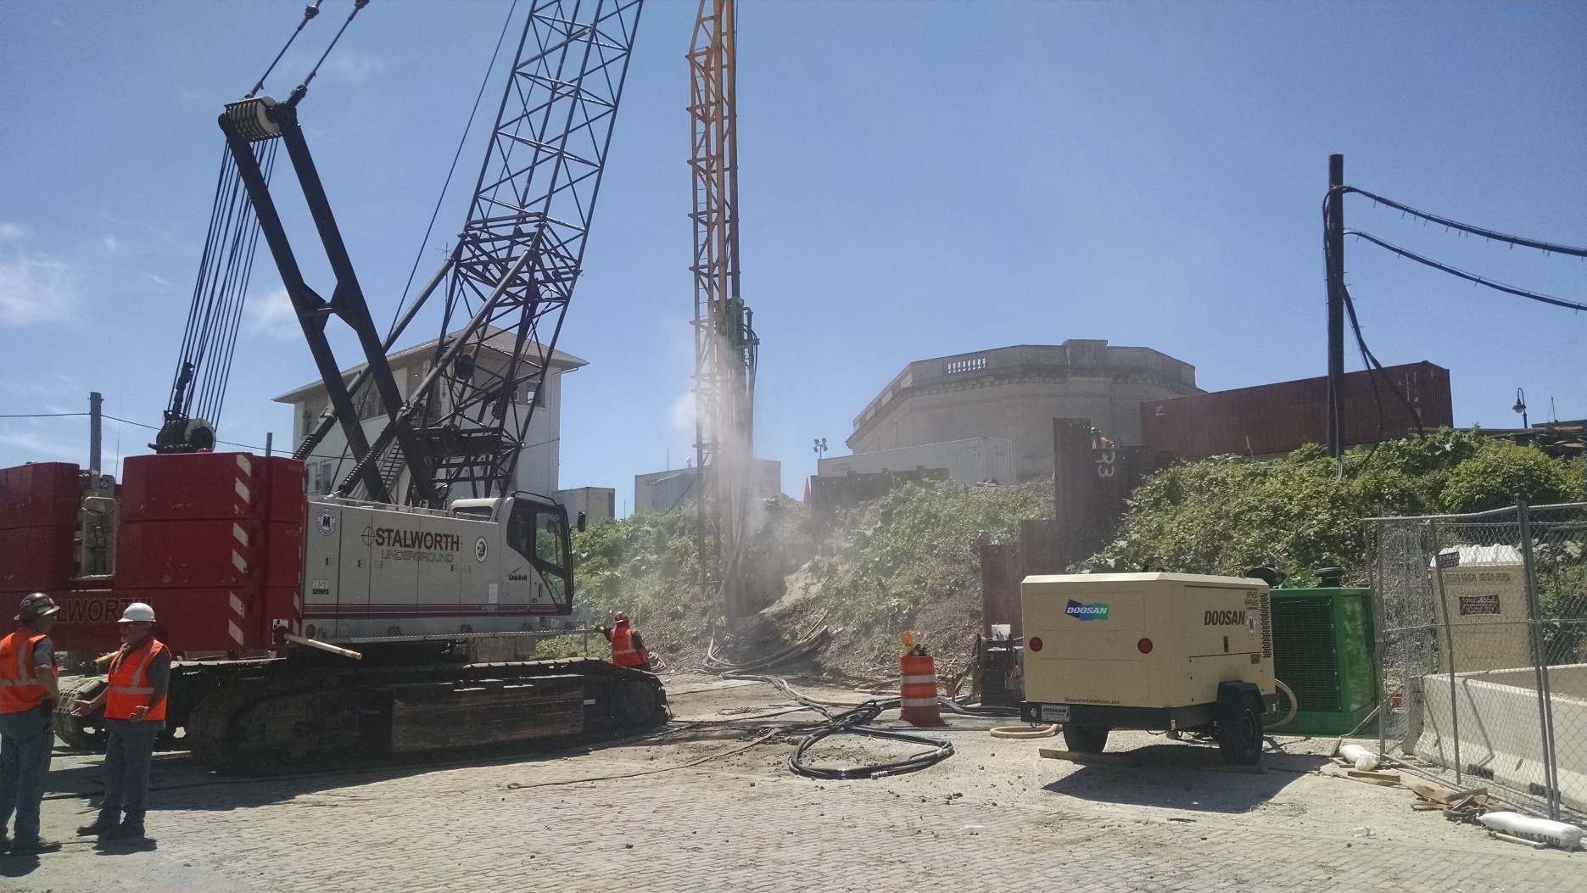
Safety Standards for Pile Driving
Draft 11 30 2023

Slide 2
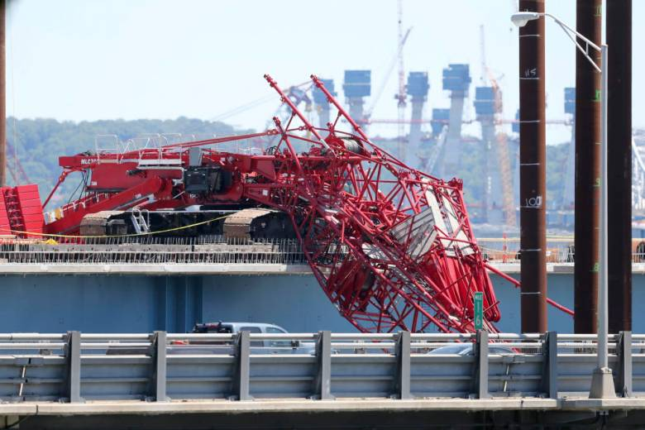
July 2016
Tarrytown NY
Cuomo said the crane that collapsed had been using a vibratory hammer to drive in pilings when it "had an issue" that caused its boom to fall onto the existing bridge nearby.
Manitowoc MLC 300
Soft spot for the pile?
Notes:
One theory, Mr. Loughlin said, was that the pile had struck a very soft spot of river mud and had begun to sink rapidly, jolting the 60-ton hammer into a rapid drop and putting a particular strain on the boom, which buckled.
Mr. Loughlin, emphasizing that he could only speculate about what had happened until the investigations were complete, said that an operator on an old-fashioned crane with a foot-operated brake might have taken his foot off the brake and allowed the load of the hammer to go into a free fall, relieving the strain before the buckling occurred.

Slide 3
Jan 2017

Slide 4
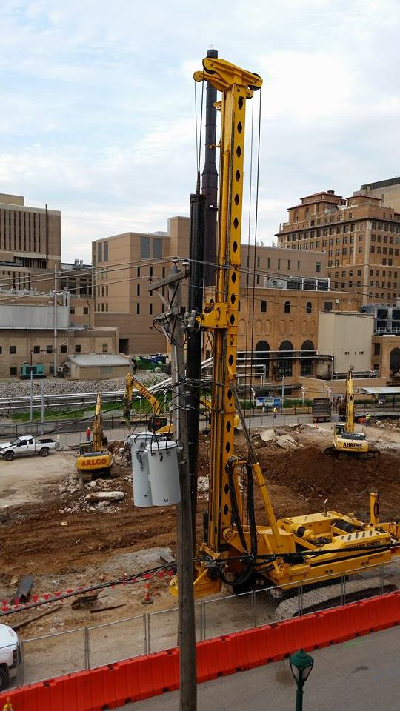
Pile Driving Safety
1926.1408(b)
Issue?
Power lines!
St. Louis Aug 2015

Slide 5
ANSI A10.19
4.1 Prior to pile driving or extraction operations, a geotechnical report shall be developed to identify subsurface conditions and provide geotechnical conclusions and recommendations for design and construction of the project.

Slide 6
ANSI A10.19
4.2 A site safety plan shall be prepared by the project constructor in conjunction with the pile driving contractor and shall be reviewed with all employees involved in or exposed to the pile driving operations on the project.

Slide 7
ANSI A10.19
4.4.1 The project constructor shall: 1. Inform the pile contractor of the depths and locations of subsurface hazards (such as voids, tanks, utilities) where pile driving equipment will be used.

Slide 8
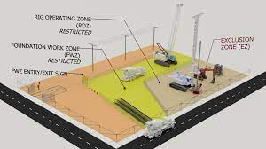
ANSI A10.19
4.4.1 .4 Organize and conduct a preconstruction meeting with the piling contractor to review the ground conditions, working platform design, installation, and maintenance, site access, location of laydown areas, delivery routes, and the site-specific safety plan.

Slide 9
ANSI A10.19
4.4.2 The piling contractor shall: 1. Prior to initiating pile driving or extraction operations, develop a written site-specific safety plan and job hazard analysis (JHA) of the tasks involved with pile driving or extraction operations.

Slide 10
ANSI A10.19
4.4.2 .1 b Such site specific plans shall include, but are not limited to,
working over or near water,
fall protection,
rescue from heights,
water rescue,
emergency actions for fire,
severe weather, the location(s) of utilities (both above and below grade),
designated areas for equipment operations and materials storage,
assembly and disassembly sequences for pile driving equipment,
operation of pile driving equipment,
designated parties permitted within the restricted access zone,
the handling and storage of pile materials, equipment, pile cut off operations,
waste disposal,
mobile elevated work platform setup and use, and
project de-mobilization

Slide 11
ANSI A10.19
4.4.2.3 The piling contractor shall determine the ground bearing pressure generated by the pile driving/extraction equipment while under the maximum predicted load

Slide 12
ANSI A10.19
4.4.2.4 Establish a restricted access or fall zone around the installation, driving, hoisting and/or extraction areas to prevent access by persons not directly involved in such operations (i.e., persons other than the piling contractor’s personnel, and pre-approved personnel performing observation and testing services).

Slide 13
ANSI A10.19
4.4.2.5 Pile Selection
Selection of pile types, lengths, bearing capacities, etc. is an engineering decision, made consistent with the geotechnical report, and shall be made by a registered professional engineer and not delegated to any other party.

Slide 14
ANSI A10.19
8.2 Only rigging in good condition and of adequate size, configuration, and capacity shall be used to handle piles.
All rigging shall be inspected prior to use by a qualified person.

Slide 15
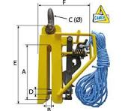
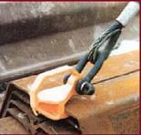
ANSI A10.19
8.3 Piles shall not be hoisted with open hooks or open sheeting shackles.
Special custom grabs, hooks, clamps, or other lifting accessories shall be designed by a registered professional engineer, marked to indicate the safe working loads, and shall be proof tested prior to use to 125 percent of their rated load

Slide 16
ANSI A10.19
9. Power Equipment 9.1 All equipment used for pile driving or extraction shall be inspected by a competent person before use during each shift of work activities.
Such inspections shall be documented.

Slide 17
ANSI A10.19
11.17 Where the boom, counterweight, or other structural part of a crane has been modified to accept equipment related to pile driving (e.g., leads, pile hammers, power supply), the user shall demonstrate that the modification(s) are designed by a registered professional engineer and will not affect the safe operation of the crane.

Slide 18
ANSI A10.19
11.24 The driving hammer and associated rigging shall be inspected at least once every shift by a competent person.
All retaining bolts, cable clamps, cables, cushion pads and blocks, fuel lines, rail bolts, cocking and trip mechanisms, fuel pumps, injectors, drive head retaining pins, jaw assemblies, and/or other items required by the manufacturer shall be inspected and adjusted to maintain proper functional capacities.

Slide 19
ANSI A10.19
21.4 When piles are extracted with a vibratory or impact pile hammer suspended from a crane:
1. The piling contractor shall follow the crane manufacturer’s required procedures for this operation.
At no time shall the crane’s lifting capacity for the full working radius of the extraction operation be exceeded.
The rated capacity of the vibratory or impact pile hammer’s suspension and rigging shall not be exceeded. The hammer manufacturer’s recommendations for extracting piling shall be observed at all times.

Slide 20
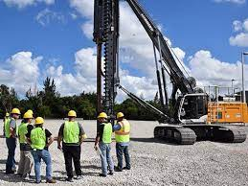
ANSI A10.19
22. Training 22.1 Only personnel who have received instructions regarding the inspection, application, and operation of pile driving and extraction equipment, including recognition and avoidance of hazards associated with their operation, shall operate pile driving and extraction equipment.
The training shall be documented
1. The purpose, and required compliance with, equipment manuals.
2. That operating manuals are an integral part of the pile driving and extraction equipment and must be properly stored in the equipment or made readily available for use.
3. A documented pre-start inspection.
4. Responsibilities associated with problems or malfunctions affecting the operation of the pile driving and extraction equipment.
5. Factors affecting stability.
6. The purpose of placards and decals.
7. Documented workplace inspection.

Slide 21
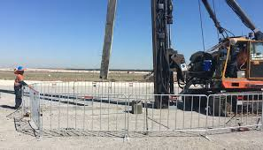
December 2018
At 9:30 a.m. on December 13, 2018, an employee was in a work area when some pile driving equipment and crane boom collapsed.
The employee was struck in the head by the pile driving equipment and was hospitalized with head trauma.
OSHA Cited 1926.1417
The equipment must not be used to drag or pull loads sideways.

Slide 22
September 2019
At 2:00 p.m. on September 13, 2019, an employee was at a construction site conducting a quality check on a piling being driven into the ground.
A 7,000 lb. pipe section rolled and struck the employee's legs.
The employee was hospitalized to treat a fractured leg.

Slide 23
September 2014
Melanie Lane Bridge over Whippany River, East Hanover, NJ On or about 9/9/2014 an employee sustained serious injury when struck by a 32 foot long by 42 inch wide steel sheet piling weighing 2,619 pounds.
The employer failed to properly secure the sheet piling from falling during pile driving activities.
Follow all manufacturer requirements for the installation and use of Dawson Construction Plant LTD EMV-450 JIC Excavator Mounted Vibrator Operators Instruction to include but not limited to: 1) Section 5.2 which requires the correct installation and use of a lifting chain and chain holder/lock during pile driving operations.

Slide 24
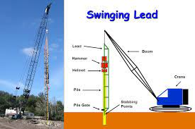
November 2010
November 16, 2011, at the construction site of the Caminada Bay Bridge, Grande Isle, Louisiana.
An employee was performing pile driving operations, and a small structural member of the pile driving leads broke loose and struck him.
He was killed but the investigation was unable to determine for certain what caused the member to break from the leads.
Employees were operating pile driving equipment that had been modified by the employer without the consent of the manufacturer and/or a Professional Engineer (P.E.).
Employees were exposed to the hazard of being struck by falling equipment and materials in the event of a failure.
Among other feasible methods to correct the identified hazard, one method would be to obtain the recommendations of a Professional Engineer (P.E.) and/or the manufacturer prior to removing portions of and/or modifying the structural members of pile driving leads

Slide 25
Questions?

