Slide 1
Heat Stress
John Newquist

Slide 2
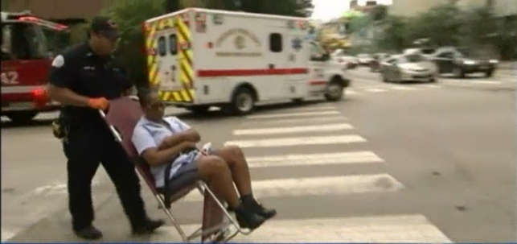
July 2016
Chicago
Thirteen people were hospitalized for heat-related illnesses at a Chicago post office Saturday morning, officials confirmed.
Temperature heat index was 107F
Air conditioning broke

Slide 3
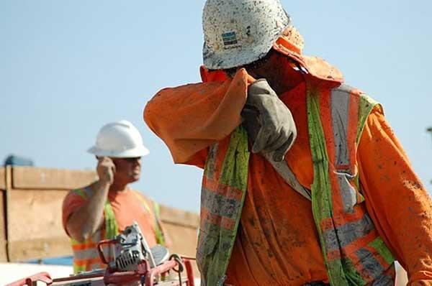
Data
2,500 workers suffered from heat illness every year
150-240 are admitted to hospital ever year.
70% die on the first day from Heat stroke.
30% under 90 degree heat index.

Slide 4
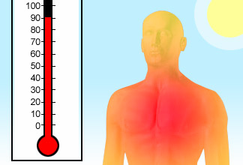
2011
Lehigh Valley, PA
Working conditions at the warehouse got worse earlier this year, especially during summer heat waves when heat in the warehouse soared above 100 degrees.
One hot day, Goris said, he saw a co-worker pass out at the water fountain.
On other hot days, he saw paramedics bring people out of the warehouse in wheelchairs and on stretchers.

Slide 6
OSHA Requirements
Use heat stress meter or get weather app
Heat stress illness prevention program
Work Rest Regimen
Employee Training
Management Training
Implement a heat acclimatization program for new employees, for employees returning to work from absences of four or more days.

Slide 7
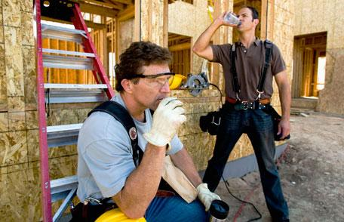
OSHA Requirements
Permit only those workers acclimatized to heat to perform the more strenuous tasks. Rotate physically demanding job tasks among acclimatized workers.
Cool drinking water and/or other hydrating beverages.
Encourage employees to drink 5 to 7 ounces of cool water every 15 to 20 minutes.

Slide 8
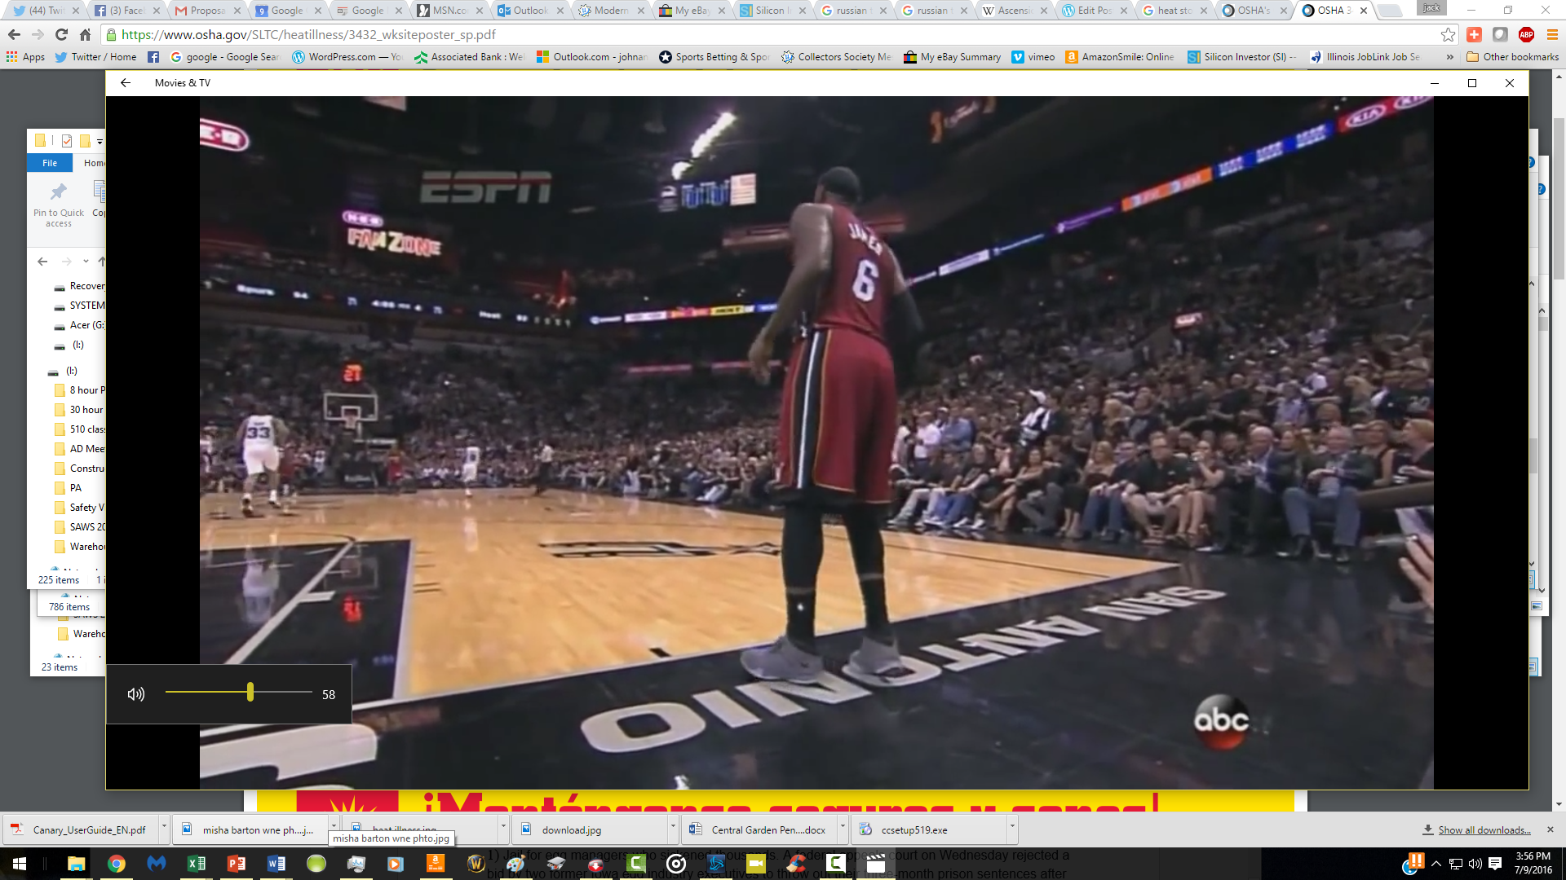

Slide 9
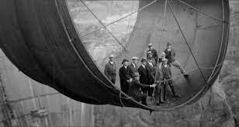
Hoover Dam
1932 – workers with heat cramps had lower concentration of salt in the blood and urine.

Slide 10
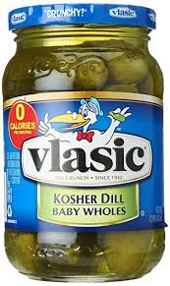
Pickle Juice?
The Cowboys and Eagles played in 109-degree heat, but the Philadelphia players seemed more energized.
The players are crediting pickle juice, which trainer Rick Burkholder recommended to combat the heat.
NYT – The reaction, for some, was rapid. Within about 85 seconds, the men drinking pickle juice stopped cramping. But the cramps continued unabated in the men drinking water. Pickle juice had “relieved a cramp 45 percent faster” than drinking no fluids and about 37 percent faster than water, concluded the authors of the study

Slide 11
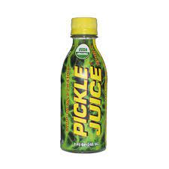
Pickle Juice
2016 Pickle juice calming reflex per MacKinnnon and Bean research.
2010 - cramps happen without change in electrolytes Kevin Miller , PhD
1997 – muscle neuro receptions imbalance cause cramps. South Africa study.

Slide 12
Anti Cramp Tactics
Sugar, Vinegar, Capsaicin have worked.
Sleep,
Exercise

Slide 13
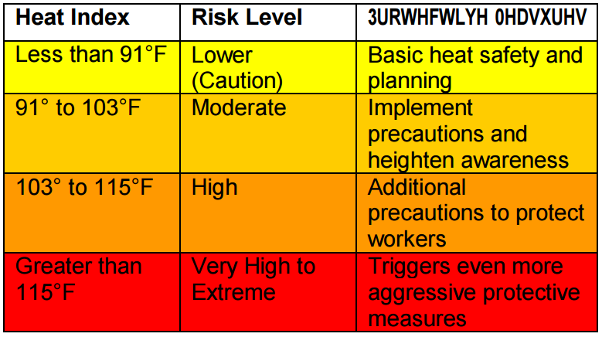
The heat index values were devised for shady, light wind conditions. Exposure to full sunshine can increase heat index values by up to 15° Fahrenheit.

Slide 14
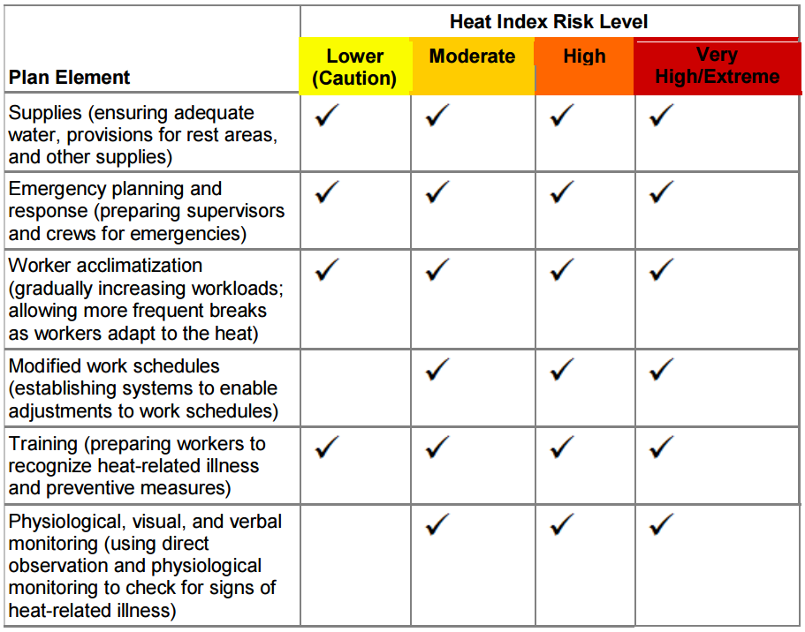

Slide 15
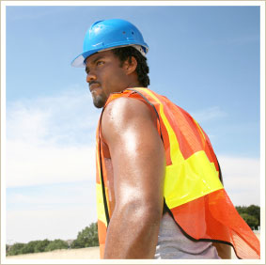
Sunburn
Heat stress can be more than a minor inconvenience for those who work in extremely warm conditions.
Symptoms:
Red, painful skin (first degree burns)
Blistering and/or peeling (second degree burns)
Treatment:
Skin lotions
Topical anesthetics
Prevention:
Limit sun exposure on bare skin
Notes:
Read more here: http://www.miamiherald.com/2013/06/27/3473078/construction-worker-dies-after.html#storylink=cpy
Read more here: http://www.miamiherald.com/2014/06/03/4156116/roofer-struck-by-lightning-dies.html#storylink=cpy

Slide 16
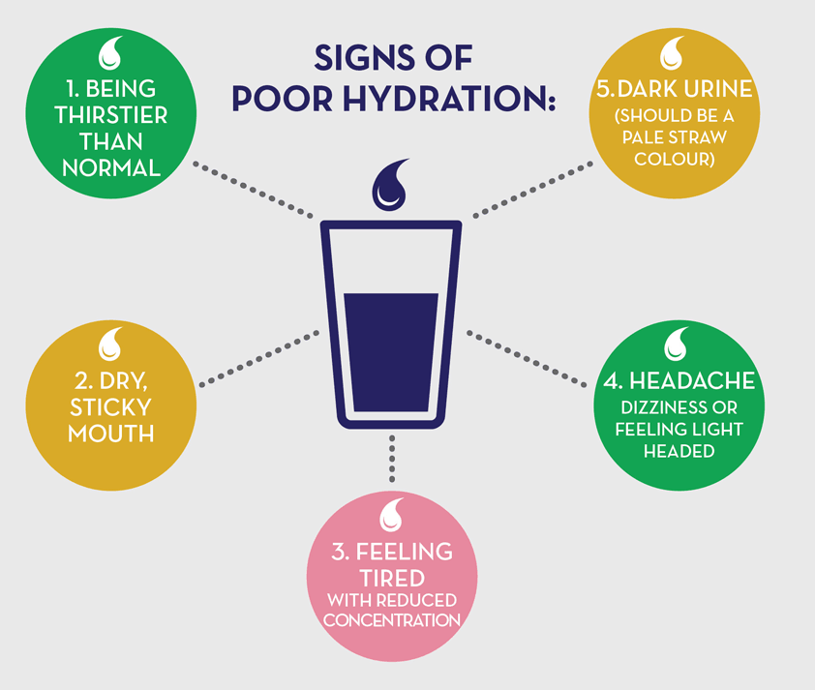
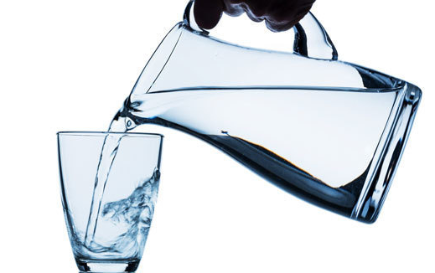
Dehydration

Slide 17
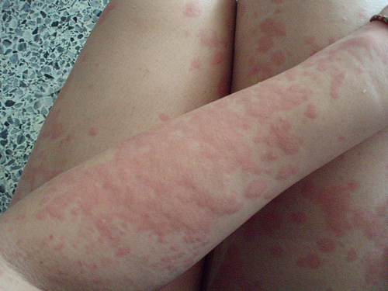
Heat Rash and Cramps
Symptoms:
Red rash and itching
Hot, moist skin
Normal to slightly high body temperature
Treatment:
Ointment – Aloe Vera
Prevention:
Keep skin dry and clean
Loosen clothing
Drink lightly salted liquids (0.1% saline)
Seek medical aid if cramps persist
Notes:
Read more here: http://www.miamiherald.com/2013/06/27/3473078/construction-worker-dies-after.html#storylink=cpy
Read more here: http://www.miamiherald.com/2014/06/03/4156116/roofer-struck-by-lightning-dies.html#storylink=cpy

Slide 18
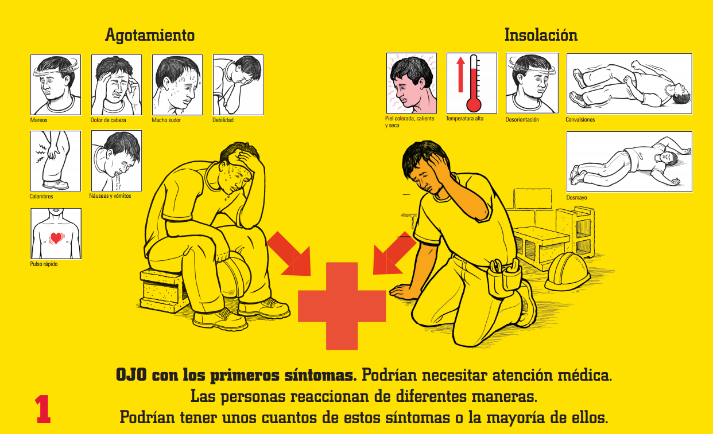

Slide 19
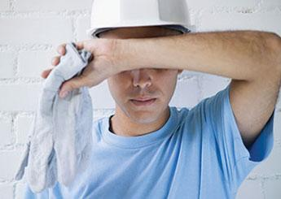
Heat Exhaustion
Symptoms:
Heavy sweating.
Intense thirst from dehydration.
Fatigue, weakness, or loss of coordination.
Tingling in hands and feet or headache.
First Aid Treatment:
Loosen or remove clothing and boots.
Cool the victim as quickly as possible.
Call 911 if victim becomes faint or is unconscious.
Notes:
Read more here: http://www.miamiherald.com/2013/06/27/3473078/construction-worker-dies-after.html#storylink=cpy
Read more here: http://www.miamiherald.com/2014/06/03/4156116/roofer-struck-by-lightning-dies.html#storylink=cpy

Slide 20
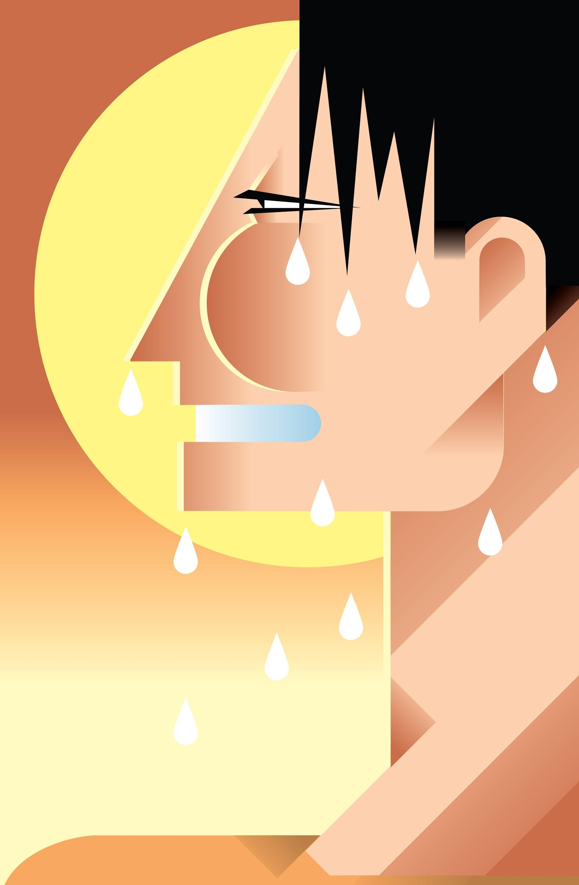
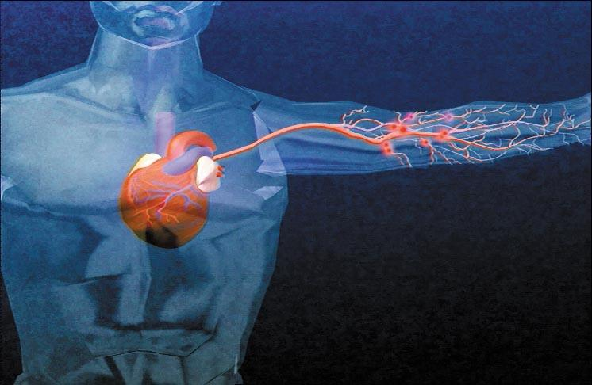
Heat Stroke
Early Symptoms:
High body temperature
Hot, red or flushed, dry skin
Headache or dizziness
Confusion or delirium
Advanced Symptoms:
Seizure or convulsions
Loss of consciousness
No detectable pulse
CALL 911 AT THE FIRST SIGN OF THE ABOVE SYMPTOMS!
Notes:
Read more here: http://www.miamiherald.com/2013/06/27/3473078/construction-worker-dies-after.html#storylink=cpy
Read more here: http://www.miamiherald.com/2014/06/03/4156116/roofer-struck-by-lightning-dies.html#storylink=cpy

Slide 21
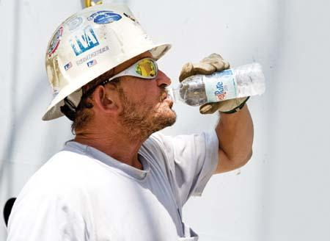
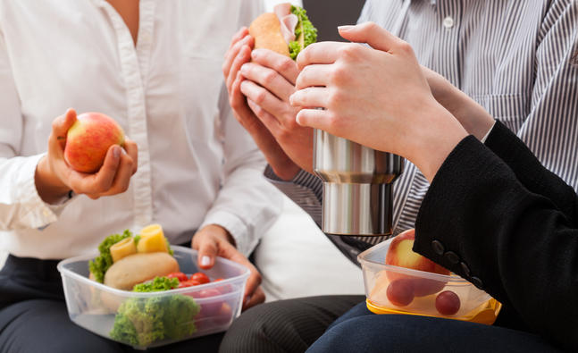
Heat Stroke
Treatment:
Lower the victim’s body temperature as quickly as possible.
Don’t give liquids to unconscious victims.
Other tips for controlling heat stress:
Allow your body to become acclimatized to your surroundings.
Follow scheduled work/rest cycles to avoid overexertion.
Drink 5-7 ounces of cool water every 15 minutes.
Consume a light, cool lunch instead of hot, heavy meals.
Notes:
Read more here: http://www.miamiherald.com/2013/06/27/3473078/construction-worker-dies-after.html#storylink=cpy
Read more here: http://www.miamiherald.com/2014/06/03/4156116/roofer-struck-by-lightning-dies.html#storylink=cpy

Slide 22
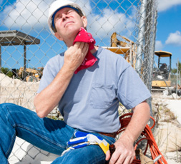
CAL OSHA Heat Illness Standard:
Cool-down Rest Periods
Must be allowed and encouraged.
Employees shall be monitored for symptoms and signs of heat illness (observation and inquiry is sufficient).
If symptoms or signs occur:
First aid or emergency response is required (based on level of heat-related illness).
Workers must not be ordered back to work, sent home, or left alone until symptoms have abated.

Slide 23
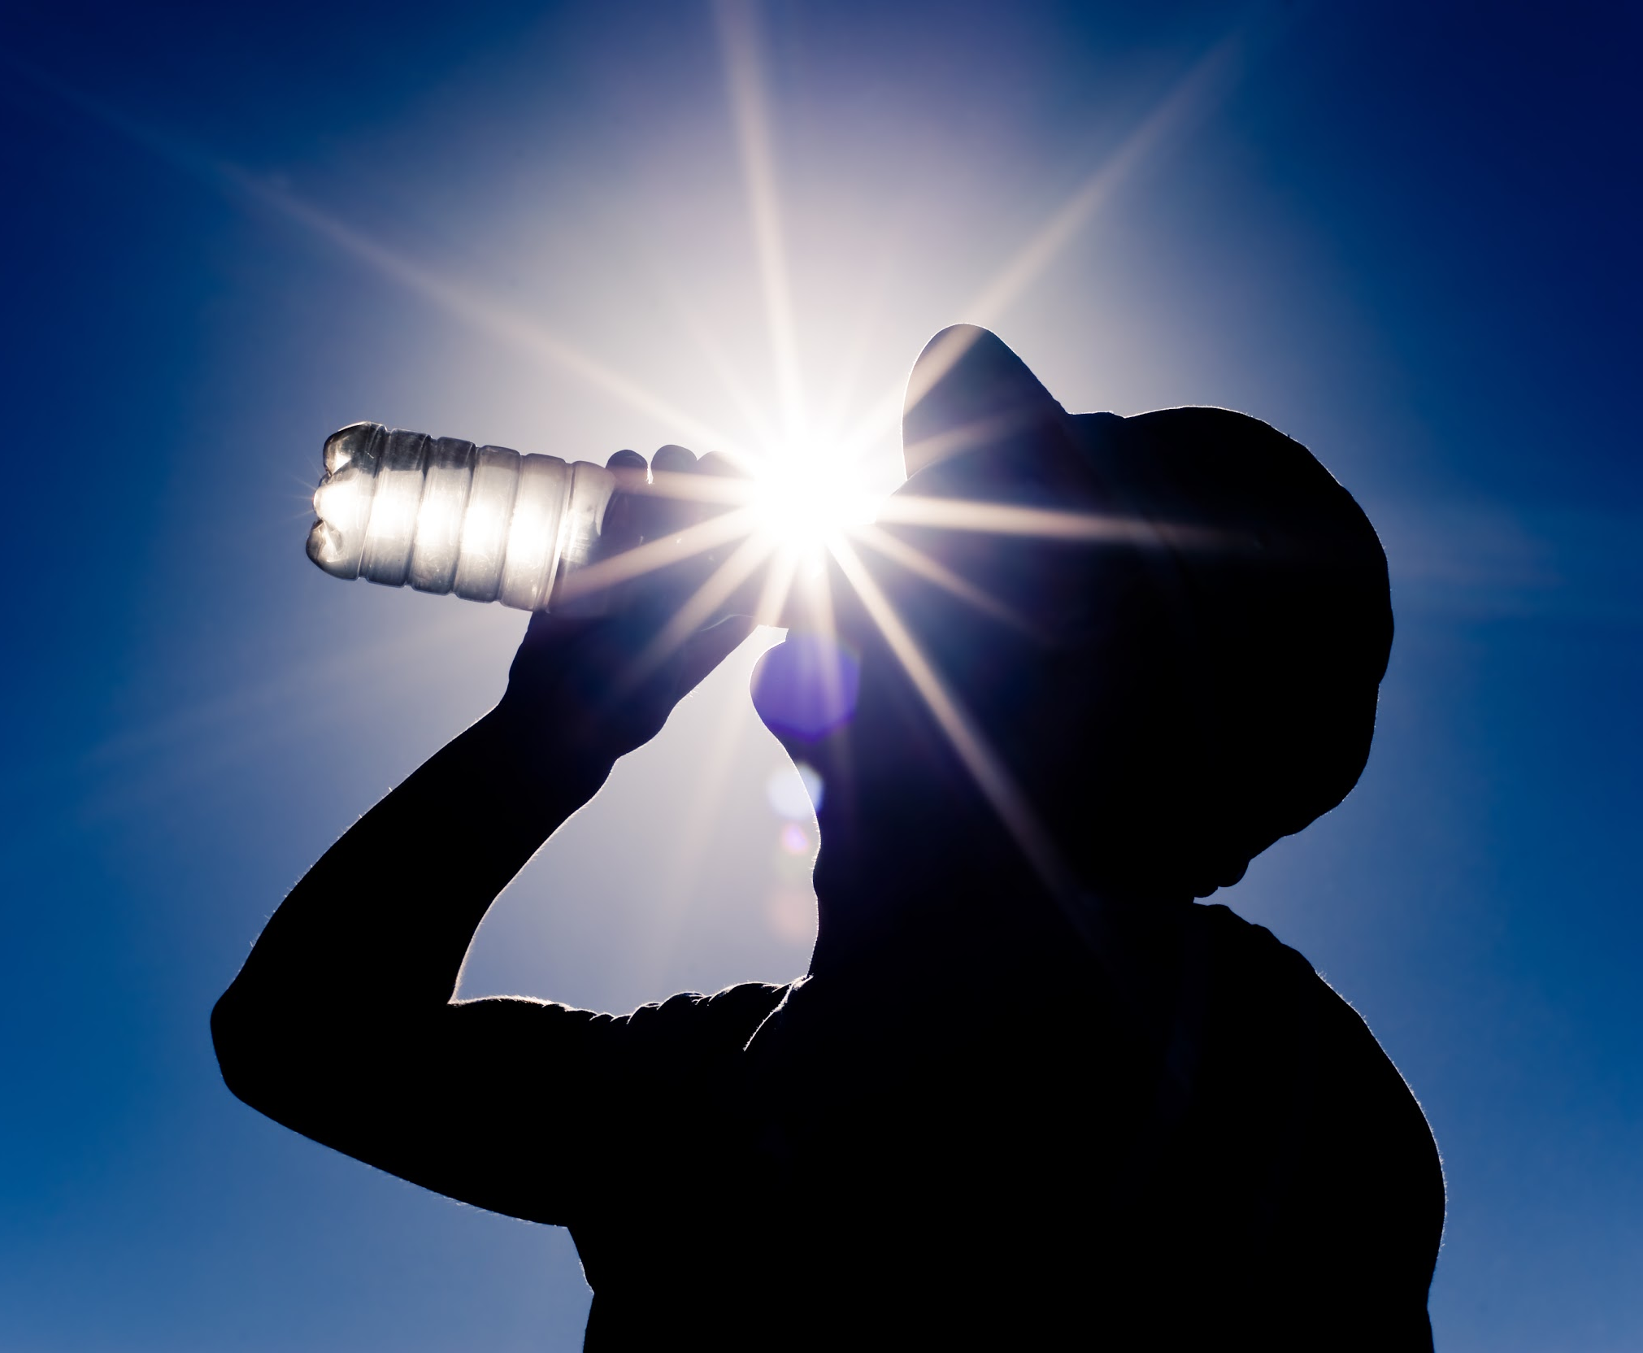
CAL OSHA Heat Illness Standard:
Water
One quart per person, per hour (2 gallons for an 8-hr shift).
Must be “fresh, pure, suitably cool… free of charge” (potable water, not ice cold).
As close as practicable to worksite (if not plumbed or supplied at site).
Educate workers and actively encourage them to drink small amounts of water often (up to 4 cups/hour).

Slide 24
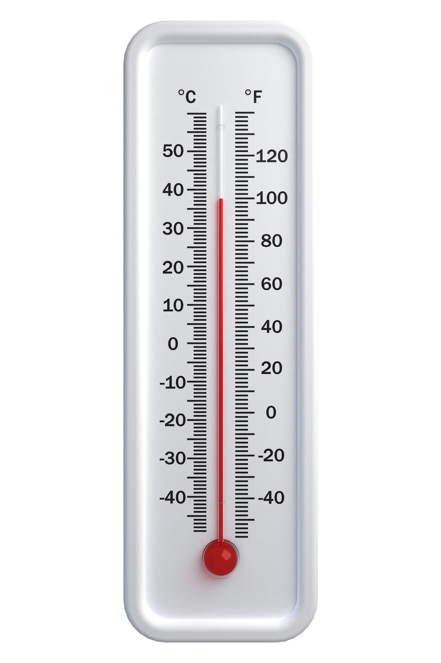
CAL OSHA Heat Illness Standard:
High Heat Procedures
Triggered at 95F (unchanged in regulation).
Pre-shift meeting to review high heat procedures.
Observation of employees for signs and symptoms.
Mandatory 10 minutes cool-down recovery time for each two hour period of continuous work.
Employees must be authorized and able to call for emergency service (or designate one employee onsite).

Slide 25
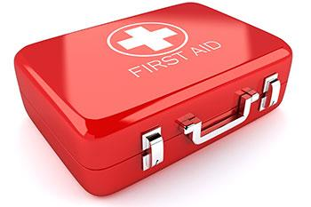
CAL OSHA Heat Illness Standard:
Emergency Response
Ensure effective communication with employees.
First aid procedures.
Emergency medical services (how and when are they provided?).
“Clear and precise” directions to the worksite.
Employees must be able to call for emergency service.

Slide 26
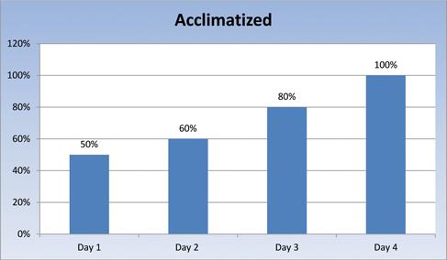
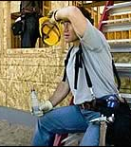
CAL OSHA Heat Illness Standard:
Acclimatization
Include concept/definition and specific procedures in training and written plan.
Applies to new employees, heatwave events, and employees returning to work after extended absence from heat.
New employees must be observed for first 14 days.
All employees observed during heat wave events (>80F AND 10 degrees higher than average of previous 5 days).
Procedure: define gradual increase in work hours over multi-day period or define alternative work arrangements.

Slide 27
CAL OSHA Heat Illness Standard: Training
Employer responsibilities and worker’s rights.
Signs and symptoms of heat illness.
Personal/environmental risk factors and acclimatization.
First aid and emergency response for various levels of heat illness.
High heat procedures (pre-shift meeting required).
Emergency response procedures.
Notes:
Can use Safety Note #20
and online training – see website links at end of presentation

Slide 28
CAL OSHA Heat Illness Standard: Written Plan
Heat Illness Prevention Plan (English/Spanish).
Must be available at worksite upon request:
Procedures for complying with standard (water, shade, training)
High heat procedures
Emergency response procedures
Acclimatization procedures
Updated template available from EHS by May 1.
Notes:
Heat Illness Prevention Plan template
Attachment H for Injury and Illness Prevention Program (IIPP)

Slide 29
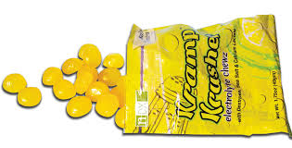
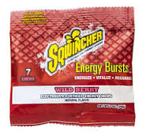
Electrolyte Candies

Slide 30
Summary
Watch New Workers
Train people in the symptoms
Take precautions above 80F
Heat Stroke needs 911 and immediate cooling

