Slide 1
Discrimination, Harassment, and Bullying in the Workplace
John Newquist

Slide 2
Ex-Purple Pig Busboy Claims Management Ignored His Sexual Harassment Complaints
The restaurant responded with a widely distributed statement mentioning a zero-tolerance policy for harassment and discrimination. It added that employees have a system to report incidents and that they “take all complaints seriously” while throughly and promptly investigating them. The restaurant also has an employee handbook with policy detailing workplace expectations, according to the statement.
Aug 2018

Slide 3
Part 1:
Equal Employment Opportunity
Protecting against discrimination in the workplace.

Slide 4
Equal Employment Opportunity (EEO)
Federal laws make it illegal to discriminate against a job applicant or employee based on: race, color, religion, sex (including pregnancy, gender identity, and sexual orientation), national origin, age, disability, or genetic information.

Slide 5
Equal Employment Opportunity (EEO)
It is also illegal to discriminate against a person because the person complained about discrimination, filed a charge, or participated in an employment discrimination investigation or lawsuit.

Slide 6
EEO Policy Statement
EXAMPLE: “It is the policy of the Employer to provide equal employment opportunities to all qualified persons, and to recruit, hire, train, promote, and compensate persons in all jobs without regard to race, color, religion, sex, national origin, disability, or sexual orientation.”

Slide 7
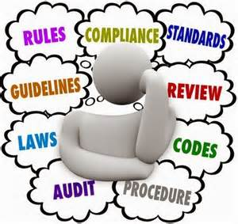
EEO Policy Statement
Typically contains language about measuring the success of your EEO program:
Evaluating EEO progress and developing alternative approaches where necessary;
Designing and implementing audit and reporting systems to allow continual monitoring of EEO progress;
Periodically auditing training programs and hiring and promotion patterns to ensure compliance with the organization’s goals and timetables.

Slide 8
How is EEO Success Measured?
Number of complaints brought to HR?
Amount of time spent on EEO issues by legal department?
Number of lawsuits filed against company?
How much spent on settlements, mediations, and conciliations of EEO claims?
These are all reactionary strategies.

Slide 9
Difficulties Quantifying EEO Success
Analyzing and understanding the data.
Communicating what the data reveal.
Educating managers in legal requirements, technical content, and statistical analysis of EEO data.

Slide 10
The SMG Index
Developed by Microsoft.
Provides a single, separate numerical index for each protected group.
Allows for comparison of a group’s performance relative to its goals or to the performance of other groups.

Slide 11
The SMG Index
Can be used as a benchmark to measure the success or failure of specific programs.
Original SMG Index was based on existing data points within standard required EEO reports.
Can be modified to focus on different job groups, departments, etc.

Slide 12
Part 2:
Sexual Harassment
Addressing gender-based harassment in the workplace.

Slide 13
What is Sexual Harassment?
Unwelcome sexual advances.
Requests for sexual favors.
Other verbal or physical conduct of a sexual nature that affects an individual’s employment, unreasonably interferes with his/her work performance, or creates an intimidating, hostile or offensive work environment.

Slide 14
Types of Sexual Harassment
Two forms of sexual harassment:
Quid Pro Quo (Latin for “this for that” or “something for something.”)
Hostile Work Environment

Slide 15
Sexual Harassment: Quid Pro Quo
Tangible employment action against the victim.
Involves monetary loss or change in job.
Example:
Mary Smith receives smaller pay increase based on performance than other employees with similar performance because she refused to go out with her supervisor, John Doe.

Slide 16
Sexual Harassment: Hostile Work Environment
Speech or conduct that is severe and/or pervasive enough to create an abusive or hostile work environment.
Example: Mike Maloney is leering (elevator eyes) at and intentionally brushing against Sally Davis.

Slide 17
Sexual Harassment: Hostile Work Environment
In addition to speech and/or conduct, the second type of sexual harassment covers explicit or suggestive items displayed in the workplace that interfere with job performance or that create an abusive or hostile work environment
Example:
Jill Jones has a 9” x 12” calendar of nude males on her cubicle wall visible to passersby.

Slide 18
Who is Involved in Sexual Harassment?
Those who commit – employees at all levels, customers, members of the same sex.
Those who are targeted – victims, bystanders and, in some cases, witnesses who are affected by the harassment.

Slide 19
Sexual Harassment: Retaliation
Retaliation: an adverse action taken against an employee because he/she complained of harassment or discrimination.
Adverse action includes demotion, discipline, termination, salary reduction, negative performance appraisal, change in job duties or shift assignment.

Slide 20
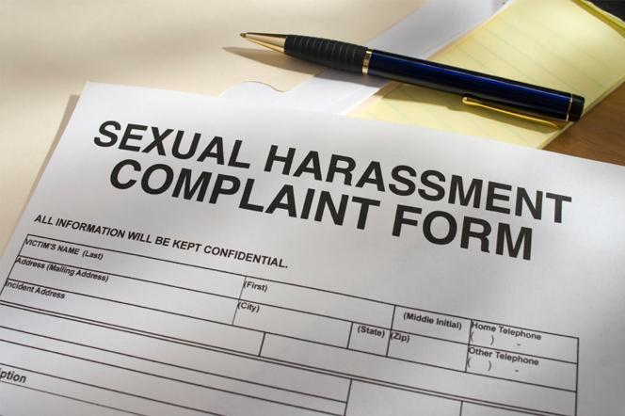
Sexual Harassment: Retaliation
Anti-discrimination laws prohibit employers from taking adverse action against employees for asserting their rights.
When an employee complains of sexual harassment to you or to others in this company or to a government agency, you must not take any action that the employee may view as punishment or retaliation for filing the complaint.

Slide 21
Sexual Harassment: Retaliation
To succeed in a retaliation claim, an employee must prove the following:
That he/she engaged in a protected activity, such as complaining of sexual harassment.
That he/she suffered an adverse employment action, such as demotion, termination.
That the protected activity and adverse action are linked.

Slide 22
Sexual Harassment: Retaliation
To avoid charges of retaliation:
Document the reason for any adverse employment action against an employee. Make sure that the documentation shows no discriminatory reason for the adverse action.
Do NOT take any adverse action against an employee who has complained of sexual harassment without discussing with and obtaining approval from the HR Director.

Slide 23
Sexual Harassment: Prevention
Why is it important to prevent sexual harassment in our workplace?
Sexual harassment harms us all. The most important part of our corporate values is to ensure all employees are treated with respect and dignity. Engaging in, condoning, or not reporting sexual harassment are in direct conflict with our values.
Compliance with Title VII of the Civil Rights Act which prohibits sex discrimination (including gender identity, change of sex and/or transgender status ).
Compliance with similar state civil rights laws and fair employment laws.

Slide 24
Sexual Harassment: Liability
Employer Liability:
Many state non-discrimination laws define “employer” to include individual supervisors, managers, or officials.
Increasingly there is risk of individual liability for these company individuals as many suits contain state law claims.

Slide 25
Sexual Harassment: Liability
Liability for the employer may be under federal or state law or civil litigation:
The company is always responsible for harassment by a supervisor that results in a tangible employment action such as a hiring, firing, promotion, demotion, change in pay or benefits, and work duties. This would be the Quid pro Quo type of sexual harassment.

Slide 26
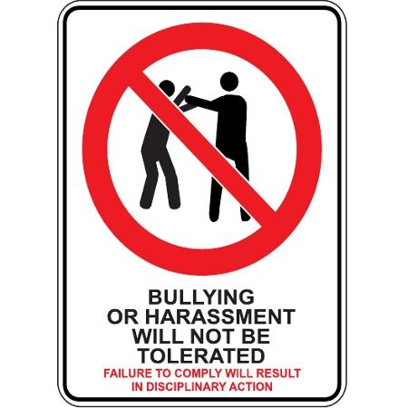
Sexual Harassment: Liability
If the harassment does not result in a tangible employment action, the employer may still be liable unless it proves that:
it exercised reasonable care to prevent and promptly correct any harassment; and
the employee unreasonably failed to complain to management or to otherwise avoid harm.

Slide 27
Sexual Harassment: Limits on Damages
Number of employees | Maximum total of compensatory and punitive damages
15 -100 | $ 50,000
101 – 200 | $100,000
201 – 500 | $200,000
501 or more | $500,000
Note: When the EEOC pursues a claim for more than one person, the damage caps are applied to each aggrieved individual.

Slide 28
Sexual Harassment: Judgements
The EEOC resolved 12,859 sexual harassment charges in FY 2005 and recovered $47.9 million in monetary benefits for charging parties and other aggrieved individuals (not including monetary benefits obtained through litigation).

Slide 29
Sexual Harassment: Judgements
One of largest and most publicized EEOC settlements:
Mitsubishi (1998) - $34 million.
EEOC sued contending that women on the assembly line in an IL factory were groped, insulted, and subjected to raunchy insults.
Women also alleged male coworkers and supervisors kissed and fondled them, demanded sexual favors, and retaliated against those who refused.

Slide 30
Sexual Harassment: Judgements
Another case:
$3.5 million – Baker and McKenzie, world’s largest law firm.
Secretary Rena Weeks accused partner and firm of creating a hostile work environment and failing to take steps against a partner.
A series of women at firm had complained of partner’s sexual harassment but firm took no action against the partner. Firm actually transferred some of complainants and fired one.

Slide 31
Policy and Procedure on Sexual Harassment

Slide 32
Responsibilities of Supervisors
Know and comply with company policy and procedures.
Immediately report any complaint that you receive from your employees or incidents that you witness involving other supervisors’ employees to the Human Resources Director.

Slide 33
Responsibilities of Supervisors
In handling sexual harassment complaints from your employees:
Demonstrate your willingness to hear and objectively discuss complaints.
Inform the employee that you must report all complaints to the HR Director.
Tell the employee that confidentiality will be respected as much as possible but cannot be assured in order to investigate fully and properly.

Slide 34
Responsibilities of Supervisors
Handling sexual harassment complaints from your employees:
Do not object if an employee prefers to or actually does bypass the standard chain of command.
Respond to any employee’s complaint as soon as possible.
Do not engage in retaliation against an employee who complains of sexual harassment.

Slide 35
Responsibilities of Supervisors
When investigations are conducted by the HR Director or by the company’s legal counsel:
Be available for interviews and provide as much information as possible.
Make employees available for interviews.

Slide 36
Responsibilities of Supervisors
Once an investigation has been completed, if disciplinary action is to be taken, work with the HR Director to make sure that:
The victim is not adversely affected.
The sexual harassment stops and does not recur.

Slide 37
Part 3:
Workplace Bullying
Recognizing and confronting bullying in the workplace.

Slide 38
Workplace Bullying
“Bullying is the sexual harassment of 20 years ago; everybody knows about it, but nobody wants to admit it.”
Surveys conducted in 2002-2003 by Business Research Lab found:
40% of employees had been victims of workplace bullying;
59% had witnessed someone else being bullied at work.
In many cases, managers or supervisors were the bullies.
Study released in 2007 by Employment Law Alliance:
45% of respondents had worked for an abusive boss.

Slide 39
Definition of Workplace Bullying
WORKPLACE BULLYING: the repeated mistreatment of one or more employees with a malicious mix of humiliation, intimidation and sabotage of performance.
It is more common than sexual harassment or verbal abuse.
(via Workplace Bullying and Trauma Institute)

Slide 40
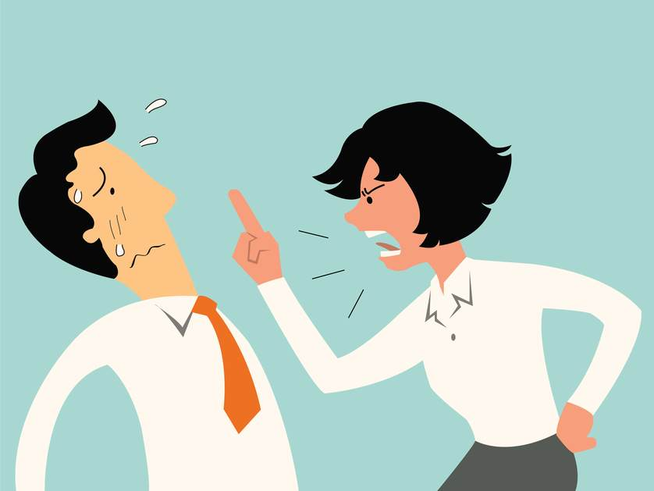
Definition of Workplace Bullying
WORKPLACE BULLYING IS… the deliberate, hurtful, repeated mistreatment of employees driven by a desire to control.
Bullying behavior may exist at any level of an organization.
Bullies can and often are managers and supervisors as well as co-workers.

Slide 41
Workplace Bullying Behaviors
Intimidating or undermining employees by demeaning their work standards, not giving them credit, setting them up for failure and constantly reminding them of old mistakes.
Threatening employees’ personal self-esteem and work status.
Isolating employees from opportunities, information and interaction with others.
Giving impossible deadlines, creating undue pressure and stress, and overworking employees.

Slide 42
Workplace Bullying Behaviors
Constant and unfair criticism.
Social bantering and teasing.
Yelling, shouting and screaming.
Insults and behind-the-back put-downs.
Hostile glares and other intimidating gestures.
Malicious gossiping.
Monopolizing supplies and other resources.
Aggressive e-mails or notes.
Overt threats and aggression or violence.

Slide 43
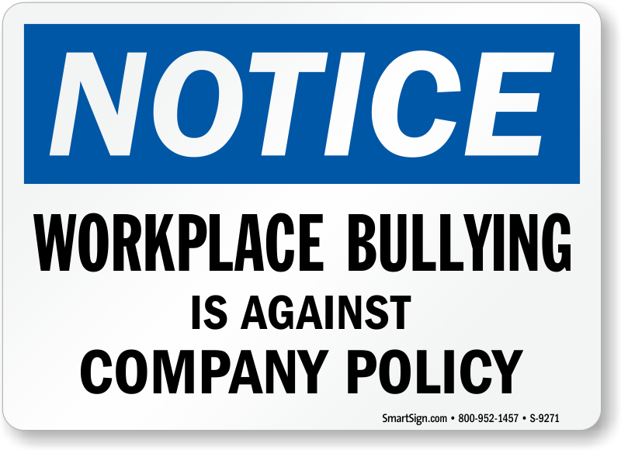
Workplace Bullying vs Discrimination and Harassment
Workplace bullying is inappropriate and unacceptable behavior, but it is not prohibited by any federal or state law.
Illegal discrimination and harassment covered by Title VII of the Civil Rights Act and under state fair employment laws pertain to discrimination and harassment based on protected group status such as age, race, gender, ethnic origin, disability and religion.
While workplace bullying may result in a hostile work environment, it is not the same illegal hostile work environment created by, for example, the employer allowing pornographic photos and objects in its workplace.

Slide 44
Workplace Bullying vs Discrimination or Harassment
Example 1:
John Smith, production line manager, calls Mary Adams, one of his assembly line workers, “sweetie pie” in a group meeting in front of her co-workers. Most of her co-workers are men. He continues, saying that she makes lots of mistakes and is slower than everyone else, but she looks really cute in her work overalls and hard hat. He calls her into his office after the meeting and says if she will go out with him, he will give her a desk job to get her off the assembly line.
Is this workplace bullying or illegal discrimination and harassment?
QUIZ:
For each of the following, state whether the behavior is workplace bullying or illegal discrimination or harassment.

Slide 45
Workplace Bullying vs Discrimination or Harassment
Example 2:
Joan Downing yells and curses at her co-worker, Paul Jones, who has a cubicle next to hers. She makes fun of his new haircut and the way he walks. She constantly criticizes his work performance and gossips to other employees about the phone conversations between Paul and his girlfriend.
Is this workplace bullying or illegal discrimination and harassment?
QUIZ:
For each of the following, state whether the behavior is workplace bullying or illegal discrimination or harassment.

Slide 46
Workplace Bullying vs Discrimination or Harassment
Example 3:
Kurt Brown, who manages the accounting department, sends nasty email messages to his employee, Peter Marks. He blames him for the backlog in the department and threatens to demote or fire him if the department does not meet its goals. He glares at him and makes fun of questions Peter asks in staff meetings.
Is this workplace bullying or illegal discrimination and harassment?
QUIZ:
For each of the following, state whether the behavior is workplace bullying or illegal discrimination or harassment.

Slide 47
Confronting Workplace Bullying
Employers must confront and stop workplace bullying because of significant effects and damage to both employees and to the company:
Employees suffering from significant physical and emotional problems, including anxiety, depression, gastrointestinal disorders, headaches, insomnia, cardiovascular disease, poor concentration, substance abuse and lowered self-esteem.

Slide 48
Confronting Workplace Bullying
Costs to the employer include turnover, higher healthcare costs, low productivity, absenteeism, low morale and retaliation that may reach levels of aggressive and violent behavior.
Above all, tolerating workplace bullying makes it impossible for employers to reach the goal of treating all employees with respect and dignity.

Slide 49
Confronting Workplace Bullying
There is no specific federal or state anti-bullying legislation in the United States, but that does not mean that employers may not be held liable for tolerating bullying in their workplaces.
If the offending behavior is pervasive enough to be considered threatening, intimidating or creating an environment full of hostility, there is potential for a claim of constructive discharge, intentional infliction of emotional distress or relating the bullying to protected class discrimination.

Slide 50
Confronting Workplace Bullying
To confront and stop workplace bullying:
Establish an anti-bullying policy that explains what bullying is and that it is unacceptable behavior.
Train managers and all other employees on the policy.
Establish processes for reporting, investigating and resolving complaints.
Conduct periodic employee attitude surveys to determine if workplace bullying is not being reported.

Slide 51
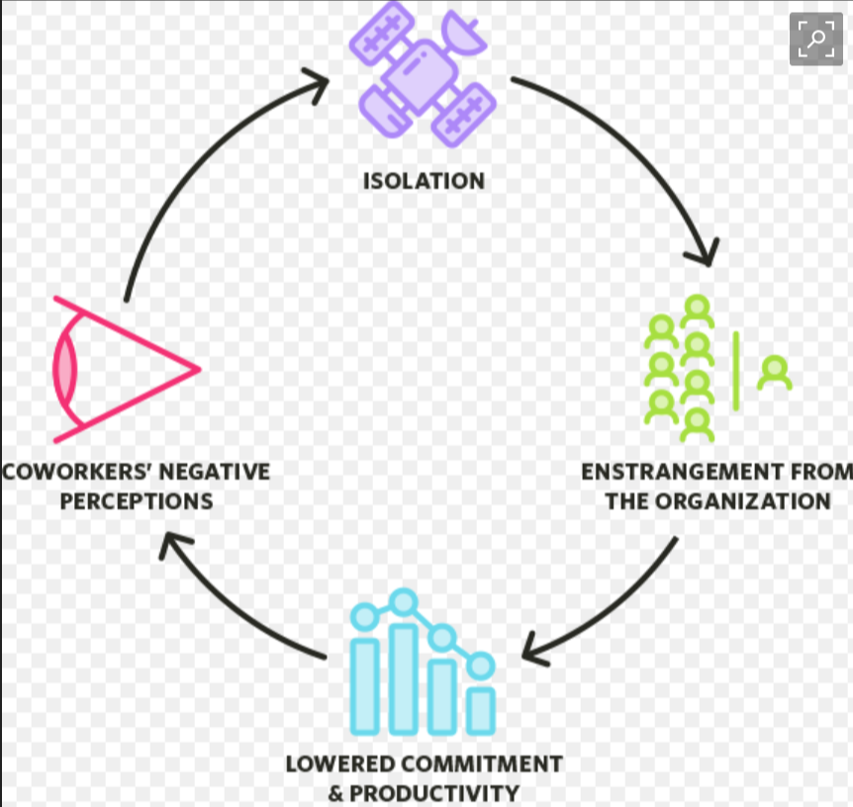
Isolation Workplace
Manager says hello to one group
Ignores the other.

Slide 52
Questions?

